Slide 1
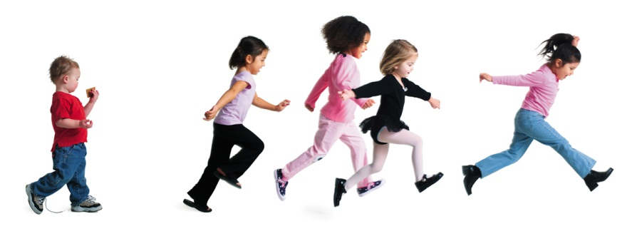

Your Logo Here
Presented to
[Logo or Name Here]
Notes:
Add staffer

Slide 2

Let’s Give Every Kid the Chance to Grow Up.
Just Imagine.

Slide 3
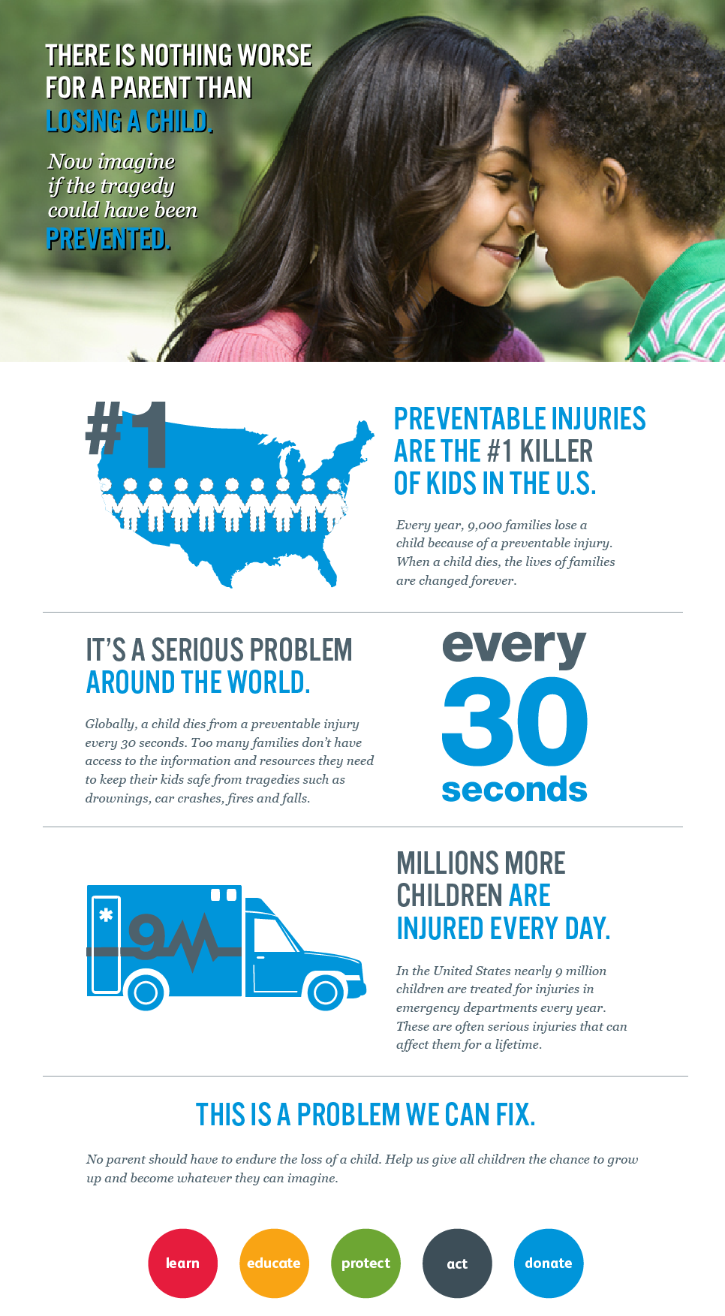
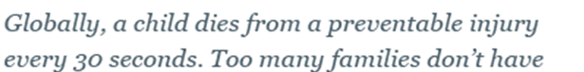

Slide 4
Insert a few key stats about child injury in your state/city.

Slide 6
Safe Kids Worldwide was founded in 1988 with a mission to keep all kids safe from preventable injuries – things like traffic injuries, fires, falls, poisonings, drowning, and the like.
Safe Kids [Coalition Name] is part of a network of 600 local coalitions across the United States who work everyday in their community to protect kids.
Locally, we’re supported by [LEAD AGENCY] and work in [geographic region].
Safe Kids [Coalition Name] and Safe Kids Worldwide are proud to be part of a movement that has worked to reduce the rate of unintentional injuries in children in the U.S. by 55% during the last twenty-five years.
But, there is still much more to be done.

Slide 7
Our Programs to Protect Kids
Child Passenger Safety
Buckle-Up/Child Passenger Safety
Certification of Child Passenger Safety Technicians
Heatstroke – Never Leave Your Child Alone In A Car
Start Safe Travel
Countdown2Drive
Distraction
Pedestrian Safety
Walk This Way
Distracted Pedestrians
Water Safety
Boating and Open Water
Pool and Spa
Start Safe Water
Fire and Burn Prevention
Start Safe Fire
Smoke and CO Detectors
Cooking Safety
Medication Safety
Safe Medication Use
Home Safety
Safe Sleep
Button Battery Campaign
Television and Furniture Tip-Over
Recreation Safety
Bicycle Safety
Playground Safety
Sports Safety
Edit as appropriate for your coalition’s focus

Slide 8
Examples of Our Work
A Selection of Programs & Campaigns
[The following slides are just a few examples – please edit/delete/add as appropriate for your coalition’s focus areas]

Slide 9
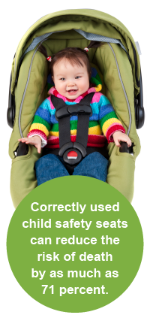
Buckle Up
  Protect children in and around cars
  Comprehensive program protecting children from car seats to teen driving
  73% of car seats are installed improperly
  Program Reach to Date
  X people directly reached through events
  X child safety seats checked
  X child safety seats distributed to underserved

Slide 10
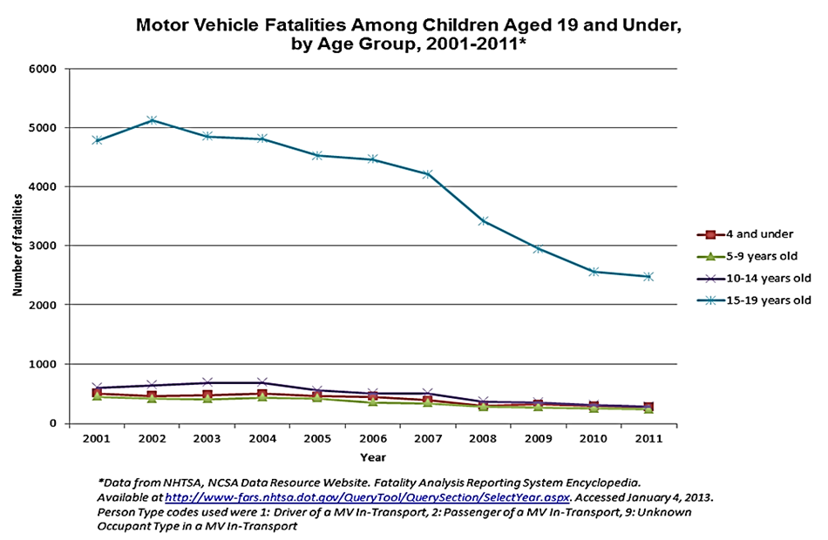
Buckle Up

Slide 11
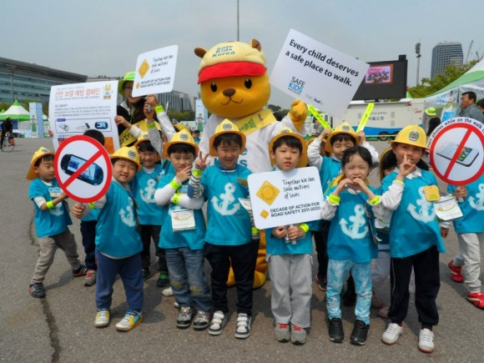
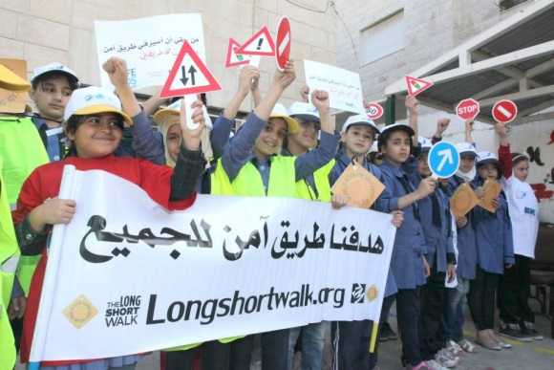
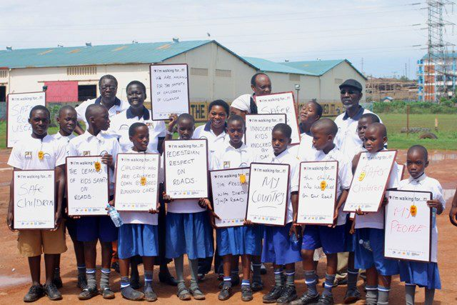
Walk This Way
  Prevent pedestrian-related injury to children
  Teach safe behavior to motorists and child pedestrians
  Results
  32% decrease in child pedestrian deaths in last decade in US
Use photos from your WTW events

Slide 12
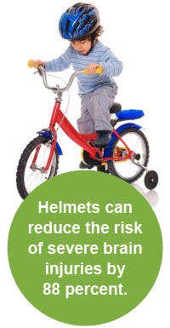
Bike Safety
Protect kids from bike-related injuries
National Bike to School Day – First Week of May
  Held events at schools and in communities for kids and parents to promote safely biking to school, proper helmet fit and creating safe routes to school
  In 2013, 232 NBTSD events held across U.S.
  X students reached
  X total participants
  X free helmets distributed

Slide 13

Water Safety
Prevent drownings, the #1 cause of injury-related death among children under 4
  Partner with local organizations and educators to teach water safety at home and in and around pools, spas and open bodies of water
  Offer free or discounted swim lessons, CPR classes and life jackets through many local Safe Kids coalitions
  Start Safe: Water program emphasizes three key messages for families when in and around water: Lock, Look, Learn
  Kids Don't Float gives children and families the opportunity to borrow life jackets from loaner stations near lakes or marinas

Slide 14

Sports Safety
Prevent serious sports-related injuries to kids
  Annual research report to drive awareness efforts and program focus
  Host local clinics for parents, coaches and kids
  Areas of focus include acute and overuse injuries, dehydration and concussion
  Game Changers Video

Slide 15

T.V. & Furniture Safety
  Launched in December 2012 to prevent death and injury to children from television and furniture tip-overs.
  TV tip-over injuries send a child to the ER every 45 minutes, on average.
  In X, we have worked on this issue by doing X

Slide 16
But, more awareness is still needed…
Which is why we’ve launched
Safe Kids Day
in our community!

Slide 17
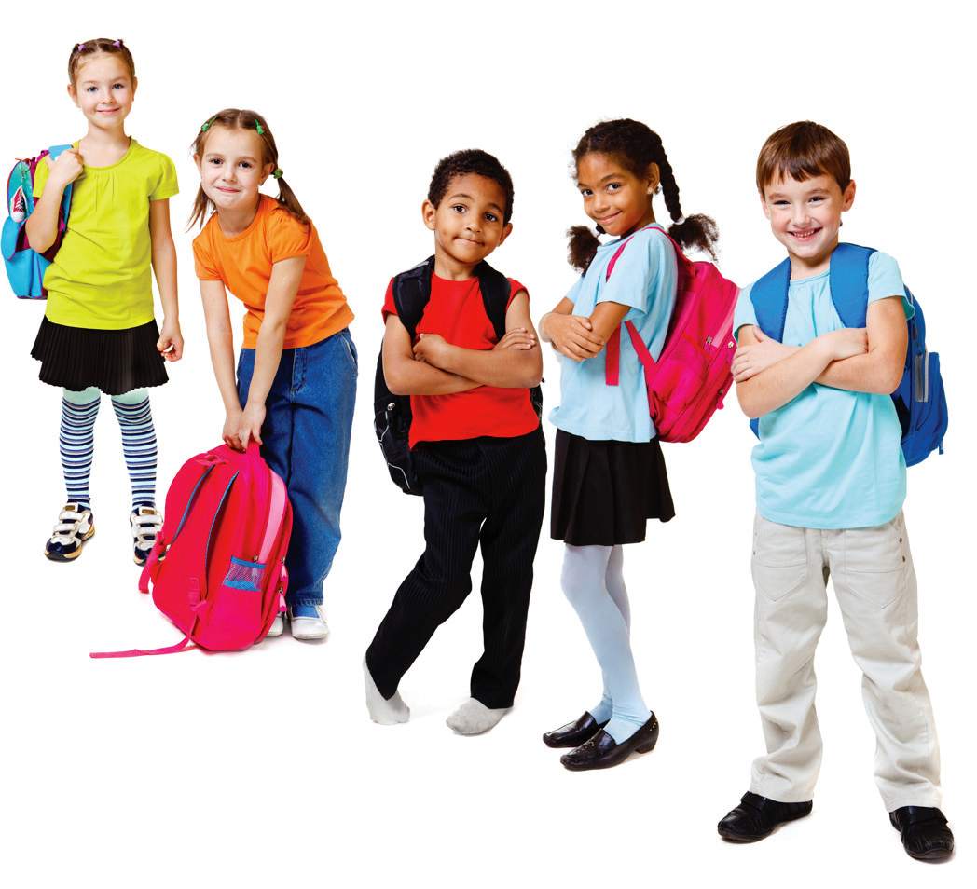


Slide 18




The inaugural national Safe Kids Day was held on May 18, 2013.
120 Safe Kids coalitions participated, and 70 Safe Kids Day events were held across the country to raise funds and awareness about child injury prevention.
SK [Coalition Name] joined in the fun by [hosting a Safety Safari at the Zoo, raising funds to support our critical programs, spreading awareness about our cause, etc.]
This year, Safe Kids Day is on April XX, and we will participate by [hosting an even bigger event at XX!].
National sponsors include Presenting Sponsor Children’s Tylenol®, FedEx and American Airlines.
Will you join us in 2014?

Slide 19
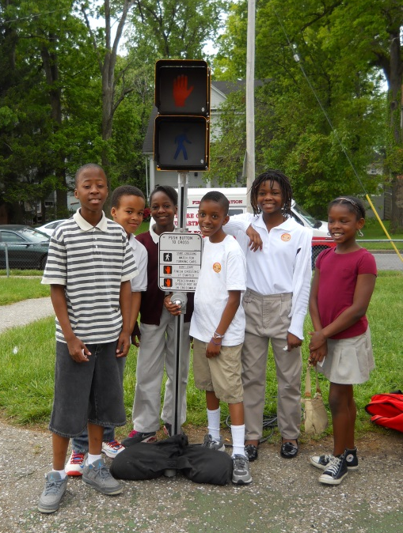
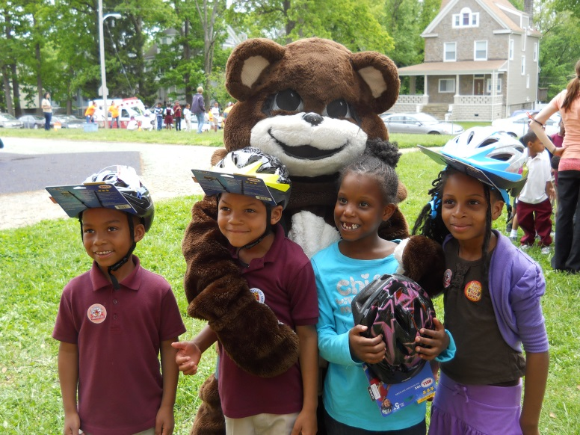
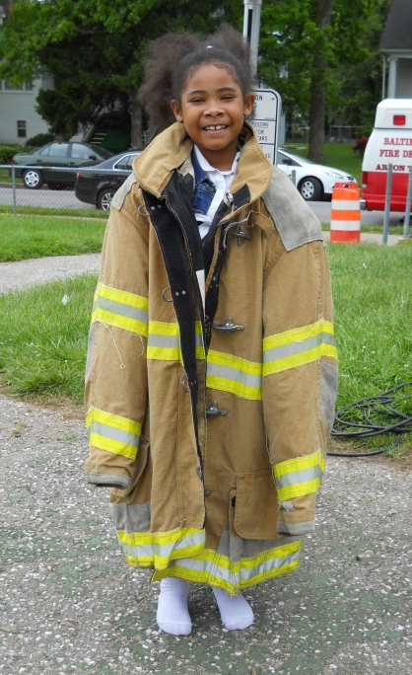
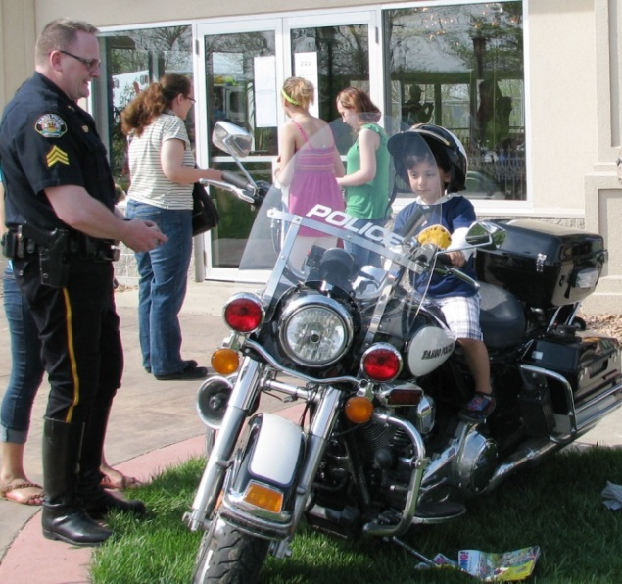
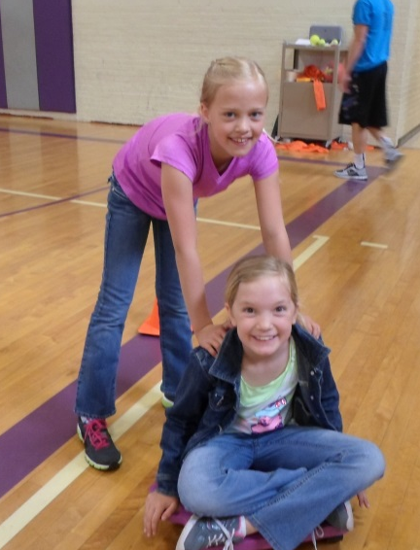
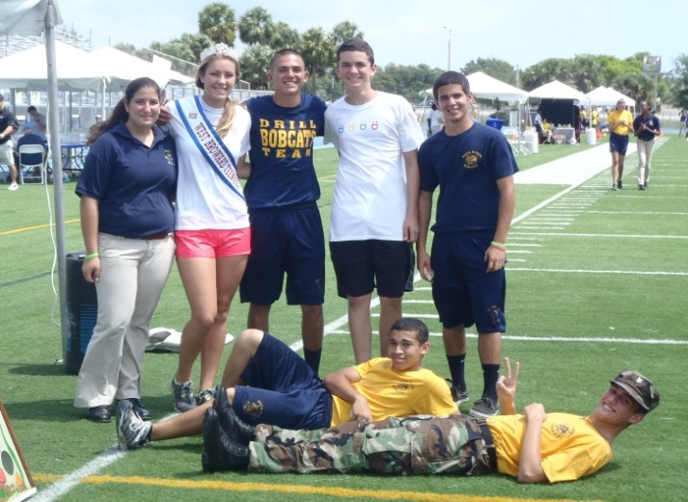
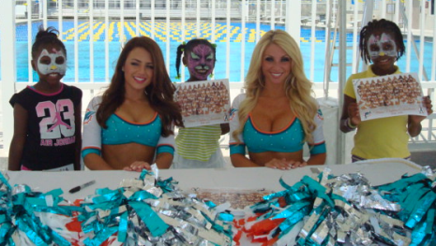
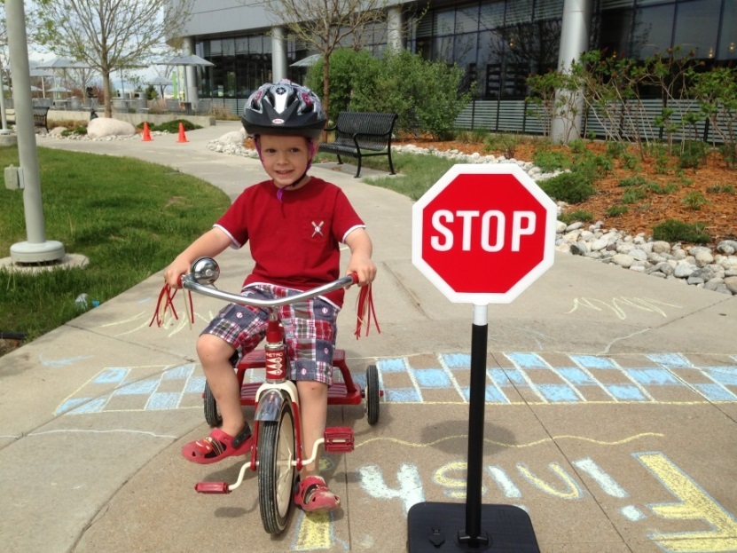
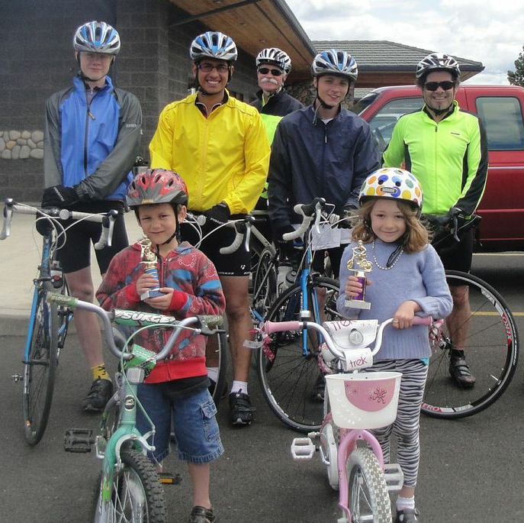
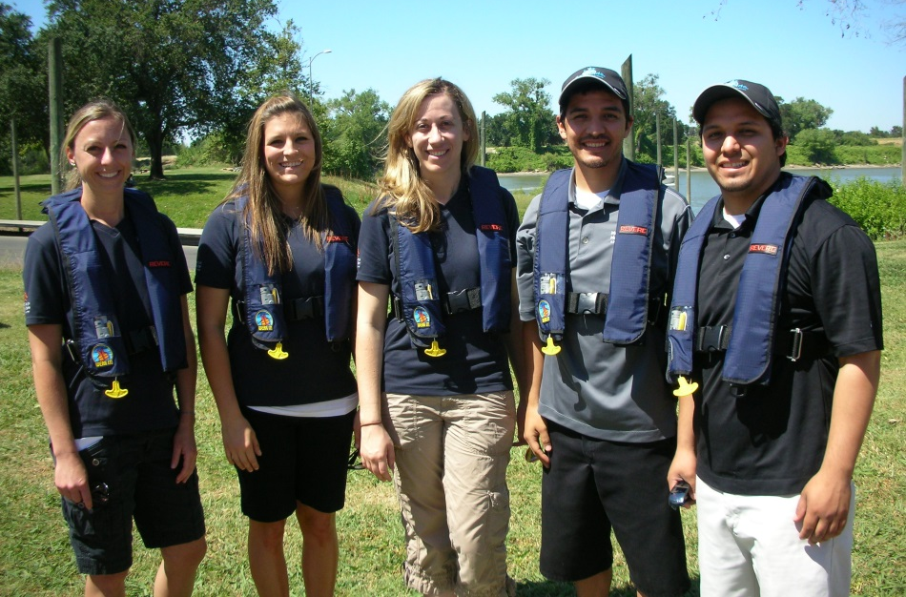
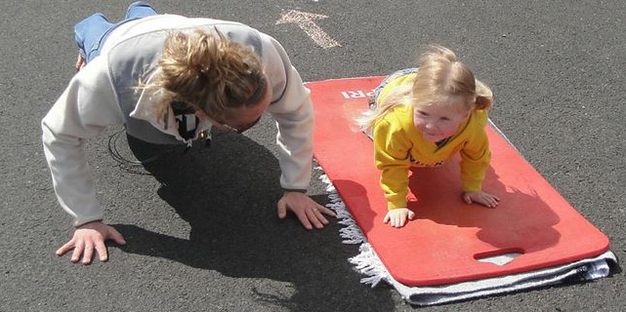
Fargo
ND
Baltimore
MD
Boca Raton
FL
If you participated with an event last year, put a slide of photos together! If you didn’t, you can show these as some examples of Safe Kids Day events held in other communities
Meade
KS
Denver
CO
LaGrande
OR
Sacramento
CA

Slide 20
Big Plans for 2014
Event
Event details – where, when, exciting ideas you have
Awareness
Engaging local media partners
Planning robust social media campaign for April
Engaging parent advocates in our community
National Safe Kids Day awareness campaign will help raise the profile of all April Safe Kids Day activities
Fundraising
Seeking local sponsors to gain recognition at Safe Kids Day event
Working with coalition members to activate individual fundraising efforts

Slide 21
Safe Kids Day
Sponsorship Opportunities
Join Us for This Important Day!

Slide 22
Local Sponsorships
Local Presenting Sponsor $5,000 - $10,000
Event – High profile recognition at event & opportunity to make remarks; Complimentary booth space to interact and hand out promotional materials
Marketing – Name/logo on all Safe Kids [Coalition Name] Safe Kids Day marketing material and invitation as Local Presenting Sponsor
Communications – Inclusion in press release
Online – Recognition on Safe Kids Day webpage and social media
Safe Kids Guardian $1,000
Event – Recognition at event; Complimentary booth space to interact and hand out promotional materials
Marketing – Name/Logo on Safe Kids [Coalition Name] Safe Kids Day invitation
Online – Recognition on Safe Kids Day webpage and social media
Safe Kids First Responder $500
Event – Booth space to interact and hand out promotional materials

Slide 23
Thank You
Key Contact Name
Title
Email
Phone

