Slide 1
Safe or Unsafe? Safety and danger in traffic Peter Spitzer Safe Kids Austria / GROSSE SCHÜTZEN KLEINE

Slide 2
Safe or Unsafe Objectives
primary school children
to check safe and dangerous traffic situations
most effective method to train participating in traffic safely

Slide 3
Safe or Unsafe Method
289 pupils (n=217)
four age groups
three different primary schools in Styria
urban and rural traffic areas
local population and immigrants
test series consisting of four different samples
face to face interviews (each approx. 20 minutes)
two tests in two days each (one week interval)

Slide 4
Safe or Unsafe Test method
test series consisting of four different samples: a traffic mat, a simulation, pictures, real life video
ten recognition tasks for each (5 safe, 5 unsafe traffic situations)
varying points of view (outside observer, from birds perspective, from drivers perspective and from children’s view).

Slide 5
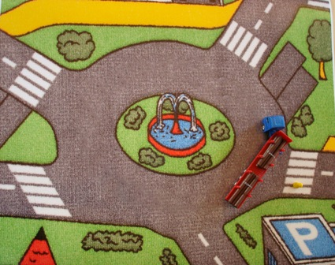
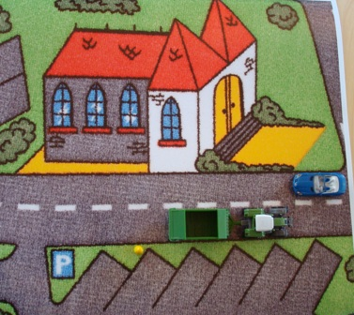
Safe or Unsafe Traffic mat
Safe Unsafe

Slide 6
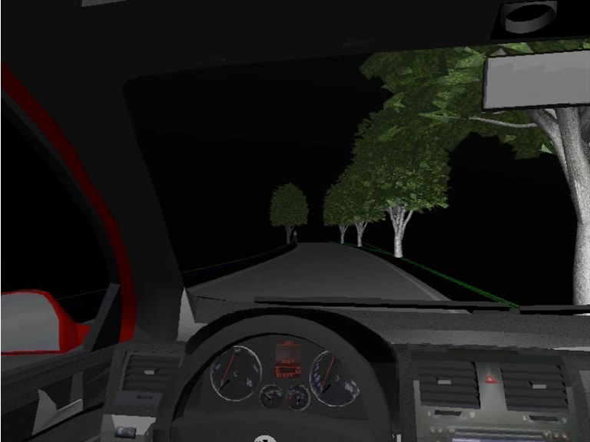
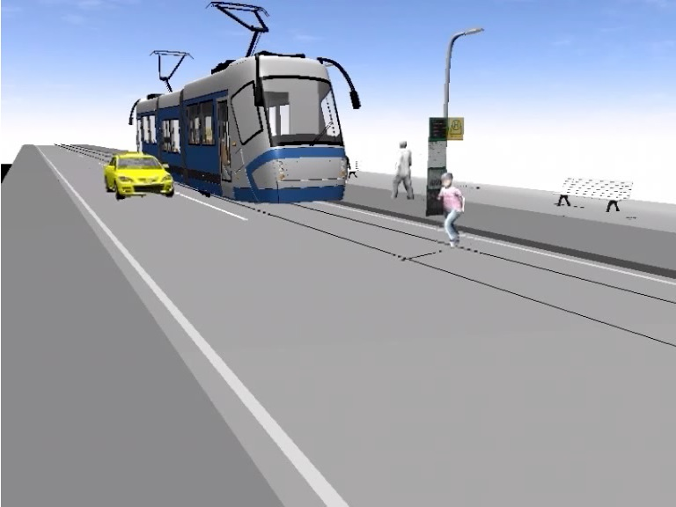
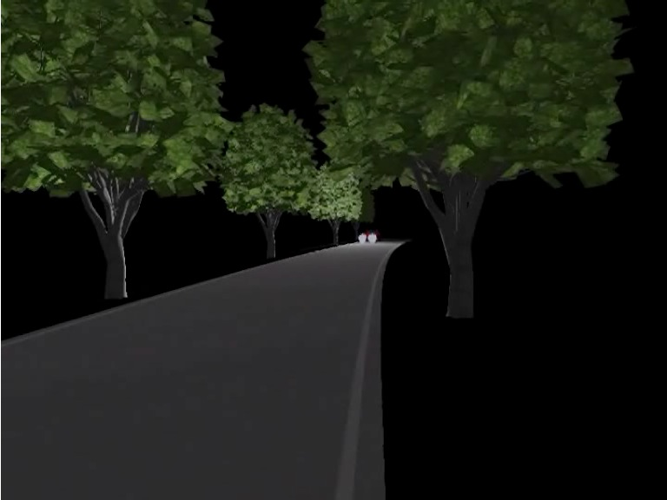
Safe or Unsafe Simulation - varying points of view
drivers perspective
outside observer
children’s view

Slide 7
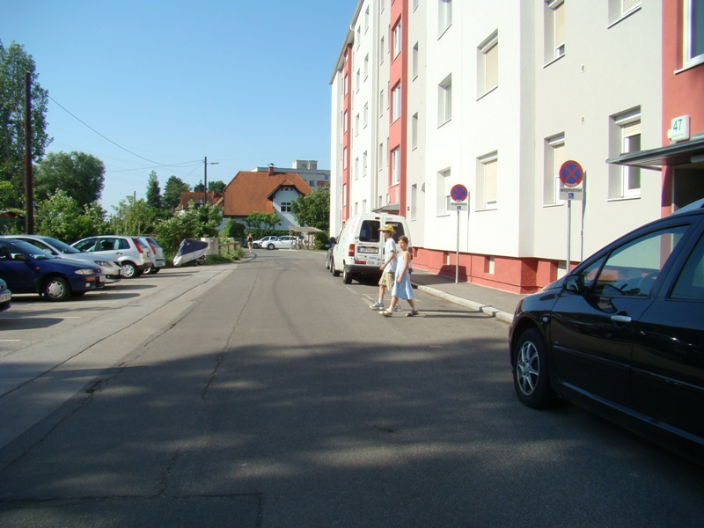
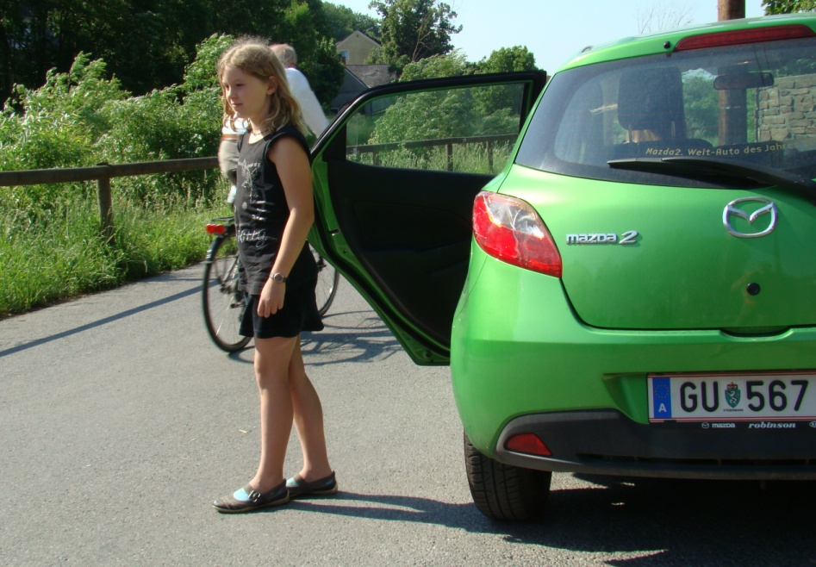
Safe or Unsafe Pictures
Safe Unsafe

Slide 8
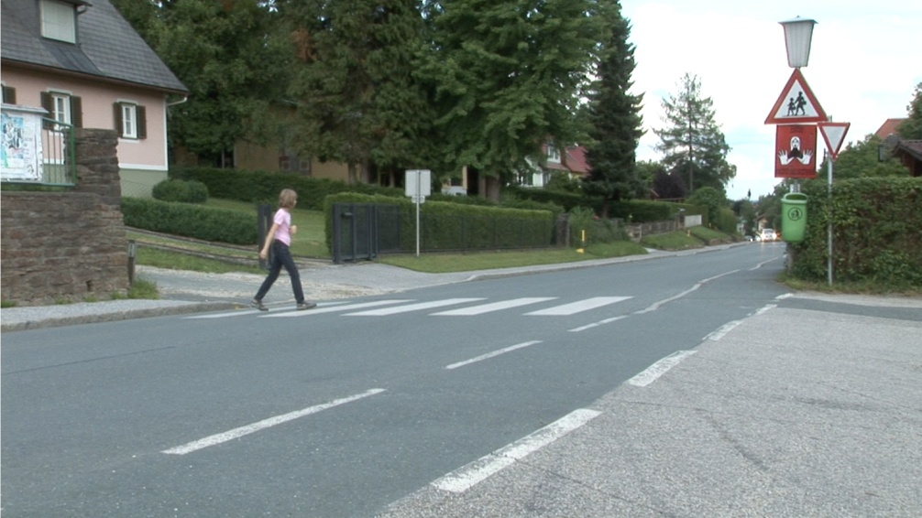
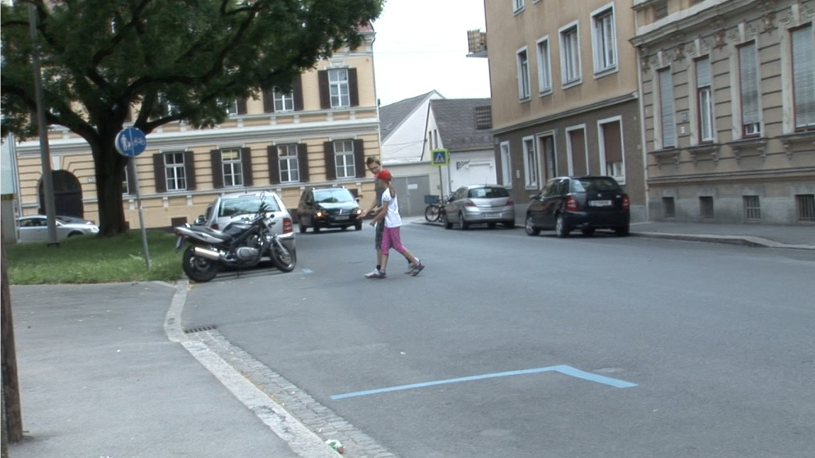
Safe or Unsafe Real life video
Safe
Unsafe

Slide 9
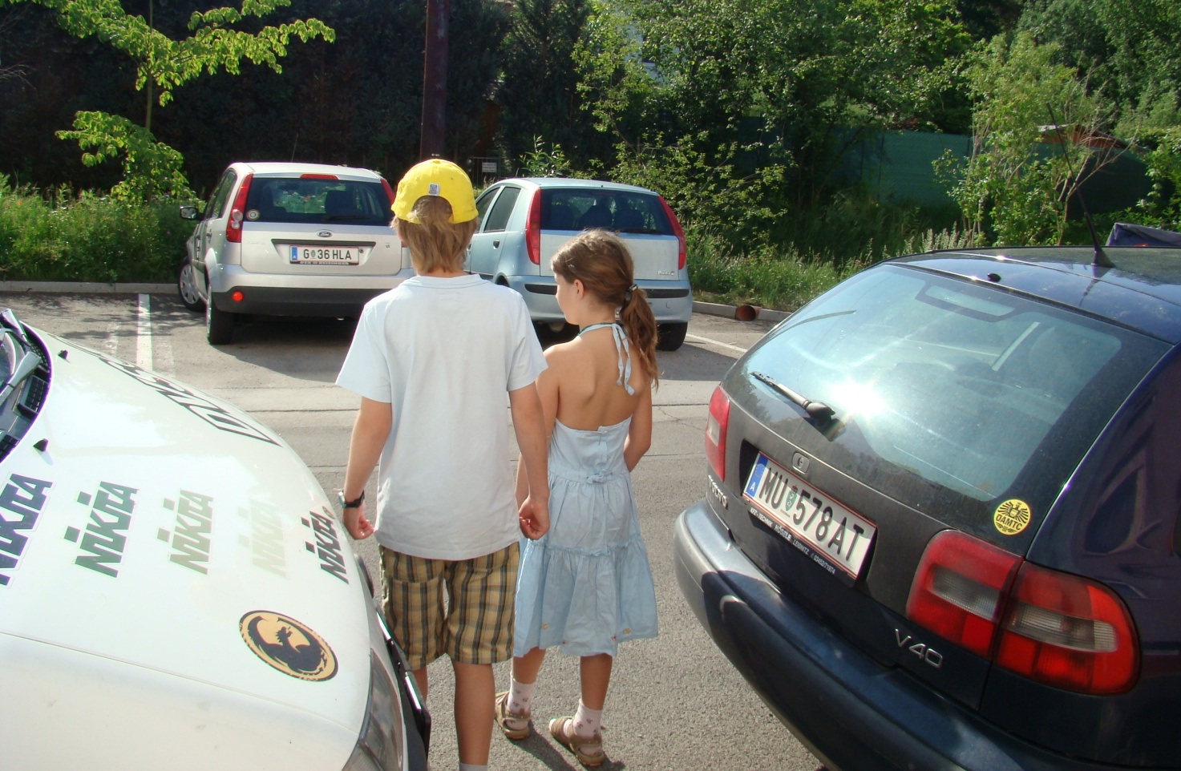
Safe or Unsafe Picture 1 - Unsafe

Slide 10
Safe or Unsafe Picture 1 - Unsafe

Slide 11
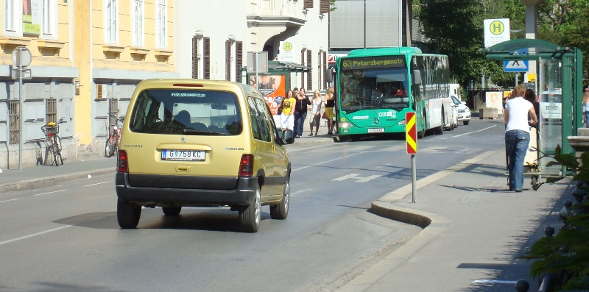
Safe or Unsafe Picture 2 - Safe

Slide 12
Safe or Unsafe Picture 2 - Safe

Slide 13
Safe or Unsafe Correct answers related to age groups
*p
P= ,000 Greenhouse-Geissler-Test
Effect: 0,116
Power: 1,000

Slide 14
Safe or Unsafe Correct answers related to test series
*p
traffic mat video simulation pictures
P= ,000 Wilks-Lambda-Test
Effect: 0,622
Power: 1,000

Slide 15
Safe or Unsafe Correct answers related to point of view
*p
*p
P= ,000 Greenhouse-Geissler-Test
Effect: 0,127
Power: 1,000

Slide 16
Safe or Unsafe Creteria for judgment (age groups)
P= ,000 Greenhouse-Geissler-Test
Effect: 0,085
Power: 1,000

Slide 17
Safe or Unsafe Location of school
p (B)= ,000
p (C)= ,020
p= ,455
p= ,202

Slide 18
Safe or Unsafe Results
75% correct answers at all
age trend: the younger the children, the more likely they were to base their interpretation of the traffic scenery on one single factor – the presence or absence of a car on the road
the percentage of correct answers was higher in older children but all age groups had the most difficulties in interpreting the sample from their own point of view
best performance was shown when using real life videos

Slide 19
Safe or Unsafe Conclusion
Psychomotor skills of children will mature till the age of ten. This fact influences their correct judgment of dangerous or safe sites on the road.
When children attending primary school parents are well advised not to overestimate their children´s traffic skills.
Traffic education at school can support the children in managing the road in a safe way with appropriate teaching materials. We suggest videos with real life sceneries and changing points of viewing.

Slide 20
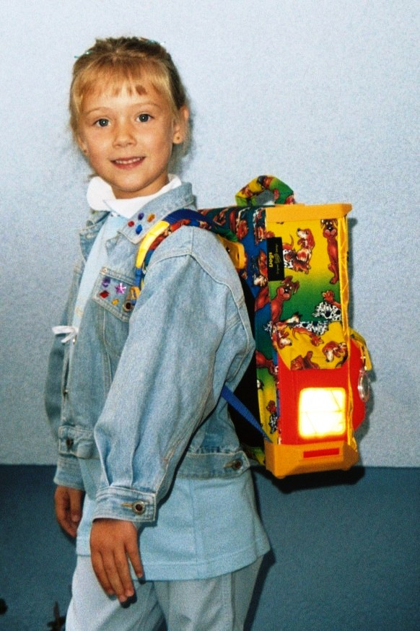
www.grosse-schuetzen-kleine.at

