Slide 1
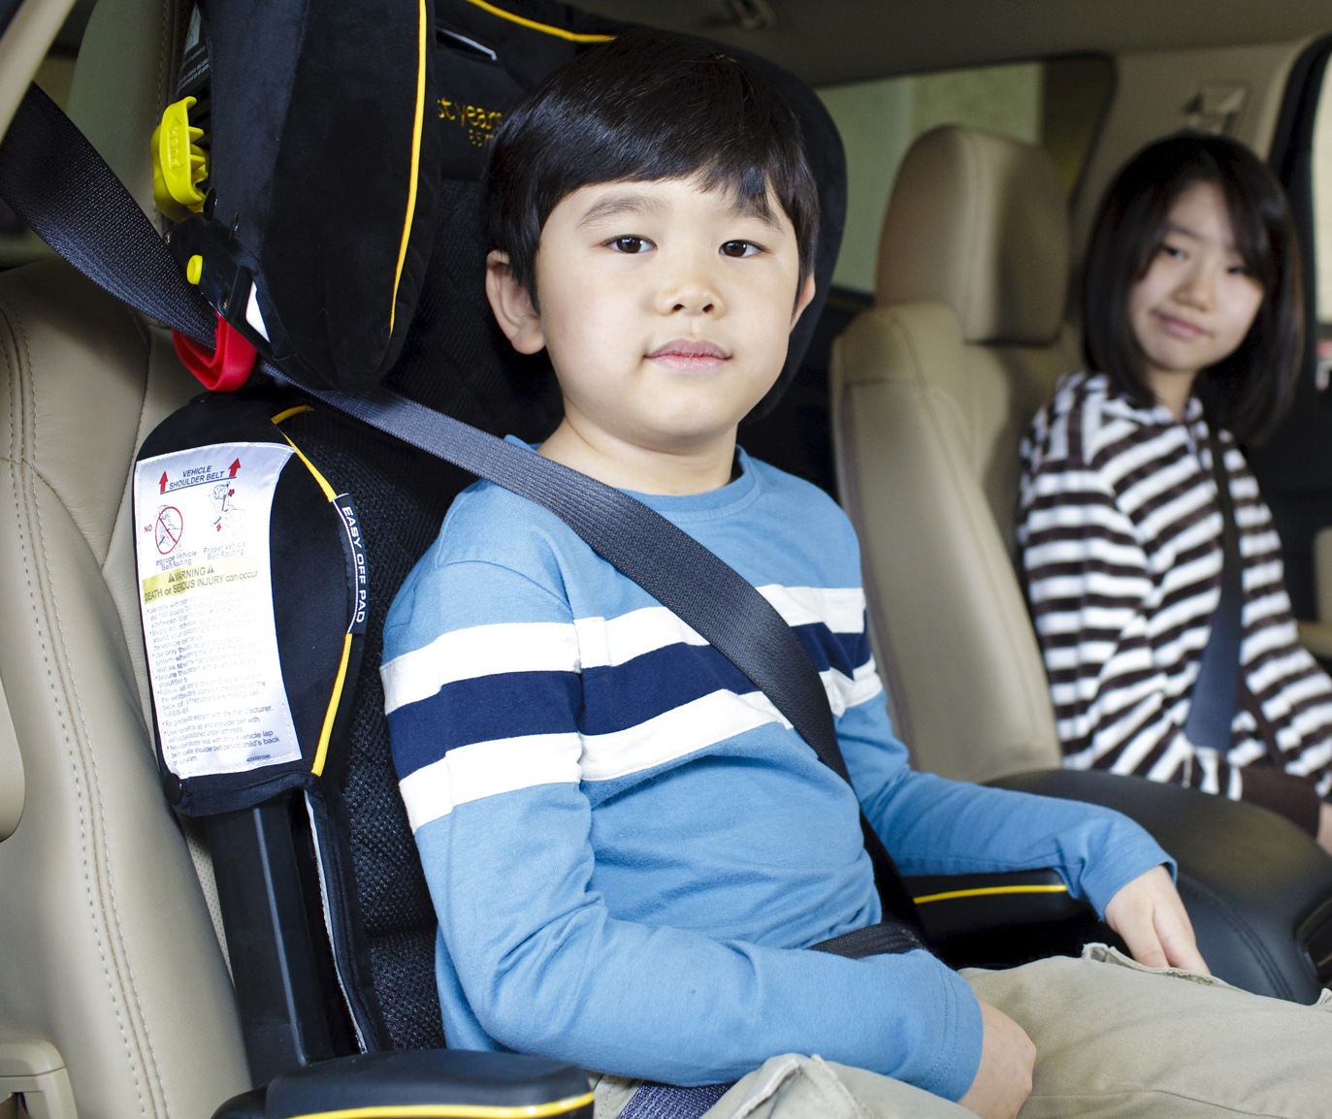
Children in
Automated
Vehicles
What do we need to know and do?
What do we need to know and do?
Notes:
Because driver error contributes to or causes the vast majority of crashes resulting in injury, advanced assisted driving features and automated driving systems are expected to significantly reduce crashes. Avoiding a crash completely is the best way to prevent crash injury.
As with any product, safe design, high quality manufacturing, sound regulations and safe practices will contribute to the optimal safety of automated vehicles.
The main purpose of this presentation is to help you understand your role in ensuring that these evolving vehicles provide a safe environment for families.
PRESENTER: This is a master slide deck to build awareness of emerging technologies as advanced driving and automated features are added to our vehicle fleet. The presentation can be customized for various audiences and timeframes, but we strongly recommend that you are completely familiar with the information and resources HERE (www.safekids.org/AV) before addressing the topic. The material at www.safekids.org/AV will be updated as appropriate, so please check before each presentation.
SUBDECKS - Guidance & Samples

Slide 2
The Automated Vehicles Consortium works to ensure that child safety needs are actively reflected in new vehicle designs, regulations, laws and educational messaging.
We are encouraged by the expansion of advanced driver assistance technologies and automated driving features, and by their promising potential to prevent or mitigate crashes caused by human error.
Our priority is to ensure that stakeholders consider the safety needs of families as these technologies continue to evolve, thereby minimizing the risk of injury and death.
Notes:
The mission statement of the Children in Automated Vehicles Consortium is a good place to frame the presentation and discussions.
Breaking it into 3 sections:
“The Automated Vehicles Consortium works to ensure that child safety needs are actively reflected in new vehicle designs, regulations, laws and educational messaging.”
- As new features and technologies are developed and implemented, we want the safety needs of families – and especially of children – to be an ongoing priority. - By including child needs throughout the development process, we can better avoid potential injuries.
“We are encouraged by the expansion of advanced driver assistance technologies and automated driving features, and by their promising potential to prevent or mitigate crashes caused by human error.”
- If a crash doesn’t happen, neither do crash injuries.
Over the next few minutes, we are going to tell you about some of the benefits automated vehicles offer – including removing human error from the crash equation in many cases.
“Our priority is to ensure that stakeholders consider the safety needs of families as these technologies continue to evolve, thereby minimizing the risk of injury and death.”
Vehicle developers manufacturers and marketers, car seat manufacturers, regulatory agencies, lawmakers and families themselves play a role in keeping children safe as vehicles become more automated.
We will need help providing education and informing policymakers about the needs of kids and the best ways to keep them safe.

Slide 3
Today’s Discussion Topics
What do Driver Assistance and Autonomy mean?
How will they benefit families?
When will they become available?
Will they be safe?
What are the challenges?
Driver-Assistance and Autonomous Features:
Advanced technologies that use sensors, radar, cameras and software to identify safety risks and warn or assist the driver
Notes:
NOTE: This topic list applies if the full slide deck is used. Custom decks based on condensed timeframes or specialized audiences may require adjustment.

Slide 4
Driver Assistance & Autonomy
Safety and convenience features like anti-lock braking and cruise control have been developed since the 1950s. Advanced safety, driver assistance and foundation systems have existed and evolved since the early 2000s and continue to advance.
Notes:
While the concept of automated driving seems futuristic to many people, systems have been developed and integrated for over 60 years.
Many more advanced technologies were developed and have been evolving over the past 20 years, and continue to evolve and be tested today.
Additional information and examples are on the slides that follow.

Slide 5
On the Way to Automated Driving
Advanced Safety Features
Electronic stability control
Blind spot detection
Forward collision warning
Lane departure warning
Advanced Driver-Assistance Features
Rearview video systems
Automatic emergency braking
Pedestrian automatic emergency braking
Rear automatic emergency braking
Rear cross traffic alert
Lane centering assist
Partially Automated Safety Features
Lane keeping assist
Adaptive cruise control
Traffic jam assist
Self-park
Fully Automated Safety Features
Driverless vehicles
Notes:
How futuristic is it? Many of these features and systems are currently available!
This categorized list identifies some of the most common features on the road and in development.
Each feature category enhances safety on its own, and also represents a step toward fully autonomous, self-driving vehicles.
Advanced safety features may be familiar to many participants, as they are in many vehicles.
Advanced driver-assistance features are familiar as well and are in late-model vehicles.
Partially automated safety features may be less familiar, but they are already on the road in certain vehicle models.
Fully automated safety features are beginning to emerge in limited models, beginning with Tesla’s Autopilot (since mid-2020, renamed Highway Autopilot).
NOTE: Please be aware that while common terminology is desirable, some manufacturers may choose to use trademarked names for their own features and packages.

Slide 6
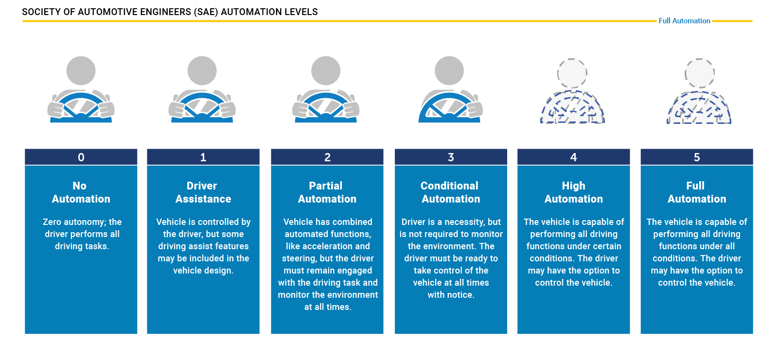
Moving Toward Full Automation
Notes:
Full vehicle autonomy is an evolution with many stops along the way, as seen in the previous slide.
Through combining the discussed features and adding new ones, common automation levels have been defined by the auto industry and regulators for vehicle models on the path toward fully autonomous vehicles.
Each will be identified with more details in slides that follow.
Level 0 identifies vehicle models with no assisted or automated features, and the graphic shows that the full attention of a driver is required.
Level 5 identifies future models that are fully automated with no driver required, and the graphic shows that no driver is required so all occupants are considered passengers.
Today, consumer vehicles in levels 0, 1 and 2 are available. More details and example models follow.

Slide 7
Level 1 – Driver Assistance
Vehicle assists the driver with a single task, such as:
braking
lane-keeping
adaptive cruise control
Increasingly common features of vehicle models for over a decade
(Many vehicles have had these features for the past several years.)
Notes:
Level 1 vehicles assist a driver with a single task, and examples of potential assistance features are listed.
These features have been increasingly common in models from the early 2000s.

Slide 8
Level 2 – Partial Automation
Vehicle assists the driver with two or more Level 1 tasks
braking
lane-keeping
acceleration
steering
adaptive cruise control
Not considered self-driving;
Human driver still required
(Examples: Tesla Autopilot, Mercedes-Benz Drive Pilot, Volvo Pilot Assist)
Notes:
Level 2 vehicles can assist with more than one task simultaneously.
Note that the example features only assist a human driver, so the driver’s attention is required.
While models change from year to year, some current models that include such Level 2 features are listed.
Level 2 vehicles are not considered self-driving.

Slide 9
Level 3 – Conditional Automation
Vehicle can self-drive from point A to point B under certain conditions.
Driver must take control in a moment’s notice in an emergency or when conditions change.
Driver must be present and attentive at all times and ready to take control
(No current examples exist on the consumer market.)
Notes:
Level 3 is the first level that has some true autonomy, but a driver must be present, alert and prepared to take control in certain situations and under certain conditions.
No consumer models currently make such features available and usable but are anticipated in upcoming model years.
Vehicle instructions may include wording such as: “Driver Assistance features are not substitutes for attentive driving. Please see your Owner’s Manual for further details and important limitations.”

Slide 10
Level 4 – High Automation
Vehicle operates autonomously, but in limited situations, such as:
Within a set geographical area
Up to a maximum speed
In favorable weather conditions
Driver or remote operator may be required for some models and situations.
Envisioned for fixed route vehicles,
like shuttles or commercial deliveries
(No current examples exist on the consumer market.)
Notes:
Level 4 is completely autonomous in limited situations such as defined geography, lower speeds and in good weather.
A driver must always be present, either in the vehicle or remotely, and must be prepared to manually take over.
While Level 4 is not yet available for consumer vehicles, it is being tested for use in commercial fixed-route vehicles.

Slide 11
Level 5 – Full Automation
Vehicle can self-drive from point A to point B regardless of weather condition or speed
No driver required
All humans are passengers
Some vehicles could be occupantless
Passengers free to shift focus (to reading, working, watching TV, etc.)
(No current examples exist on the consumer market.)
Notes:
Level 5 is fully autonomous self driving in all conditions.
No driver is required and all human occupants are considered passengers.
Some of these vehicles may provide transit with no human occupants or operators (occupantless)
No Level 5 vehicles are currently available

Slide 12
94% of serious crashes are due to human error. By reducing or eliminating human error, AVs are expected to significantly reduce crashes, injuries and fatalities.
How Do New Technologies Help?
Notes:
Now that we have a better concept of what assisted and autonomous features are and how they are classified, we will explore the benefits.
Since human errors cause the vast majority of crashes , reducing or eliminating human errors holds the promise to significantly reduce crashes.
We have already seen that trend as assistive features have been added and used, and further reducing errors will reduce additional crashes.
Some estimate that motor vehicle fatalities will be reduced by more than half as the fleet converts to more automated vehicles.

Slide 13
AV: Safety Advantages
Single-year crash toll in the U.S. (2019):
119,095 children ages 0–14 visited an ER
7,908 children ages 0–14 were hospitalized
280 children ages 0–14 died
94% of serious crashes are due to human error
AV technologies remove human error from crashes
Fewer crashes mean fewer deaths & injuries
Reductions in pedestrian and other non-occupant injuries and deaths are also expected.
Notes:
The example statistics represent children from birth through age 14 in a single year in the USA (2019)
As you can see, crash injuries requiring emergency medical attention are quite high, even when discussing children exclusively.
Motor vehicle crashes remain a leading injurer and killer of American children.
In addition to 119,095 emergency department visits, nearly 7,908 children were admitted to hospitals.
Some of the injuries may not be life-threatening, but many do require lifelong treatment or adjustment.
Another 280 of our youngest citizens were killed.
Reducing crashes caused by human error can significantly reduce injuries as a whole, reduce the severity of injuries that do occur, and reduce the number of children killed.

Slide 14
AV: Economic Advantages
Societal costs of child passenger traffic fatality and injury include medical, work loss, and quality of life loss costs:
$4.1 Billion – Emergency Department Visits
$4.8 Billion – Child Hospitalizations
$2.5 Billion – Child Deaths
$11.38 Billion TOTAL per year in the United States
Economic costs are accompanied by devastating social impacts for road users, their families, and the broader community
Elimination of crash-related deaths and serious injuries is an urgent priority.
Notes:
In addition to human life and health, crash reductions can also have economic and social advantages.
Just looking at children and including the listed cost categories, injuries cost billions of dollars each year.
These monetary costs are accompanied by devastating social costs for the children, their families and their communities.

Slide 15
AV: Additional Possibilities
AV Rideshare and other options for families
More accessible mobility for unlicensed individuals
More accessible mobility for people with disabilities
Independent possibilities for older children
Cost Savings
Likely shift in family insurance costs
Reduced product costs due to improved delivery efficiency
Further Potential
Less need for parking space if vehicles are share/active
Further technological advances and robotics
Notes:
Automated vehicles may offer additional advantages as they become more advanced and more common.
Some examples of potential are listed.
ASK: Can anyone think of additional advantages?

Slide 16
Current regulations, vehicles and laws make the driver or attending parent responsible for child safety. Regulations, laws and education must adapt to the changing technology and continue to assure child safety.
Are AVs Safe?
Notes:
Now that we know about assistive and automated features, levels and advantages, we will discuss safety.
To be certain that autonomous vehicles are safely designed and used, we need regulations and laws that consider these vehicles.
Current regulations and state motor vehicle usage laws are based on conventional technologies without automation.
These laws must be updated and supplemented to include partially or fully automated systems.

Slide 17
Blue Ribbon Panel Report
AV Developer
Call to Action
Acknowledge children are not small adults and require special developmental consideration:
Support safety standards that protect children
Usability testing with families
Inclusive design
Conduct research on appropriate supervision
Best safety practices in marketing
Recommendations for Traffic Safety Community
Regulation, Legislation, Enforcement & Policy
Education & Outreach
Notes:
In 2018, the Blue Ribbon Panel on Autonomous Vehicles and Children that preceded our Consortium efforts identified the need for vehicle developers, regulators and educators to thoroughly consider the unique safety needs of children.
In addition, the 2018 report identified that Federal regulations, usage legislation, enforcement programs and other policies must also consider these unique needs.
Furthermore, education is necessary to empower families to use autonomous vehicles safely.
Specialized outreach is also necessary for involved groups (police, 1st responders, safety advocates, etc.), as well as continued communication with designers and developers.

Slide 18
AV Risk Area Unknowns
Crashes
Forces in crashes—lower, greater, same?
Forces in crash avoidance maneuvers?
Incident rate during transition?
Will today’s child restraints be effective?
Non-Crashes
Known risks in/around cars
New risks in/around cars?
Supervision/ Responsibility
How risk tolerant/averse will caregivers be?
What rules will govern riders?
How will the public be taught?
How will rules be enforced?
Notes:
Research, experience and knowledge are necessary components for effective regulations and legislation.
While we have extensive real-world data and experience with Level 0 vehicles, significant data and experience with Level 1 vehicles and emerging data and experience with Level 2 vehicles, the more advanced levels currently depend on controlled testing, modeling and limited commercial use.
Any regulatory changes require notice and an opportunity for comment, so stakeholders should keep a watchful eye for any regulatory proposals that affect child safety in AVs
For new technologies with less published laboratory and field data available, the National Highway Traffic Safety Administration can choose to employ Advance Notice of Proposed Rulemaking (ANPRM).
ANPRM allows the Agency to collect the latest and most comprehensive information available on new technologies and proposals. The process is intended to obtain information from industry stakeholders and the public during the formulation of a regulatory change before the Agency has done significant research or investigation of its own.
Perhaps in the future, NHTSA will issue an ANPRM that will query stakeholders on the topic of children in AVs.
Some examples of broad areas with unknown risks are listed (spend more time going through these with CPS Techs, industry reps and other more technical audiences).

Slide 19
AV: An Expanding Field
+
+
+
+
+
+
+
+
Notes:
In addition to regulation, voluntary industry communications and standards can positively impact the safety of new technologies.
As you can see on the slide, some of the core industry members working on autonomous systems are well-known and widely respected companies.
NOTE: This list is not exhaustive. Additional stakeholder companies, mergers and acquisitions make the field a moving target, but the displayed logos provide a quick snapshot of some of the trusted companies involved
Since voluntary industry standards often feed future regulation, communicating child-specific safety considerations and facilitating resolution is a top goal of the Consortium.

Slide 20
Requiring Safety for Occupants & More
Recent U.S. Regulatory Actions:
Removing Regulatory Barriers for Vehicles With Automated Driving Systems (2019 ANPRM)
Occupant Protection for Automated Driving Systems (2020 NPRM)
Framework for Automated Driving System Safety (2020 ANPRM)
Notes:
While there are many unknowns, regulation is an important part of ensuring safety.
The National Highway Traffic Safety Administration must regulate the safety of assisted driving features and autonomous vehicles without hindering innovation in their development.
That difficult balance will require multiple regulatory actions as new information and data are added.
Three recent regulatory actions include:
Removing Regulatory Barriers for Vehicles With Automated Driving Systems
2019 ANPRM
Identify near- and long-term challenges with existing crash avoidance FMVSSs for Automated Driving System-Dedicated Vehicles (ADS-DVs)
Especially applicable to Level 4 and Level 5 vehicles.
Occupant Protection for Automated Driving Systems
2020 NPRM
Identify near- and long-term testing and compliance challenges for vehicles that lack the traditional manual controls necessary for human drivers
Clarify the ambiguities in applying current crashworthiness standards to ADS-equipped vehicles
Crashworthiness standards and a unified set of proposed regulatory text applicable to vehicles with and without ADS
Part of anticipated series of planned regulatory proposals
NOTE: The related Final Rule is expected to be published in 2021. It was signed off on by the prior Administration but has not been published at the time of this writing.
Framework for Automated Driving System Safety
2020 ANPRM
Collects input on the development of a framework for Automated Driving System (ADS) safety
Goal to objectively define, assess, and manage the safety of ADS performance
Feedback on key components that can meet the need for motor vehicle safety while enabling innovative designs

Slide 21
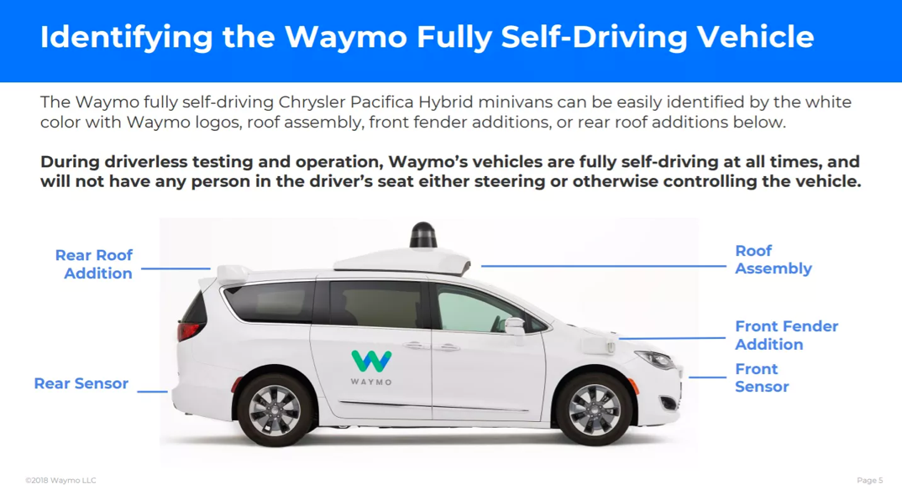
Currently in Use for Real-World Testing
Notes:
With new technologies, a great deal of testing is required in both completely controlled environments and real-world applications.
One example of real-world testing is Waymo, a company affiliated with Google that operates a commercial self-driving taxi service in the greater Phoenix, Arizona, area (https://waymo.com/)
Testing has been rapidly expanding in recent years, and can be tracked here:
https://www.nhtsa.gov/automated-vehicles-safety/av-test-initiative-tracking-tool

Slide 22
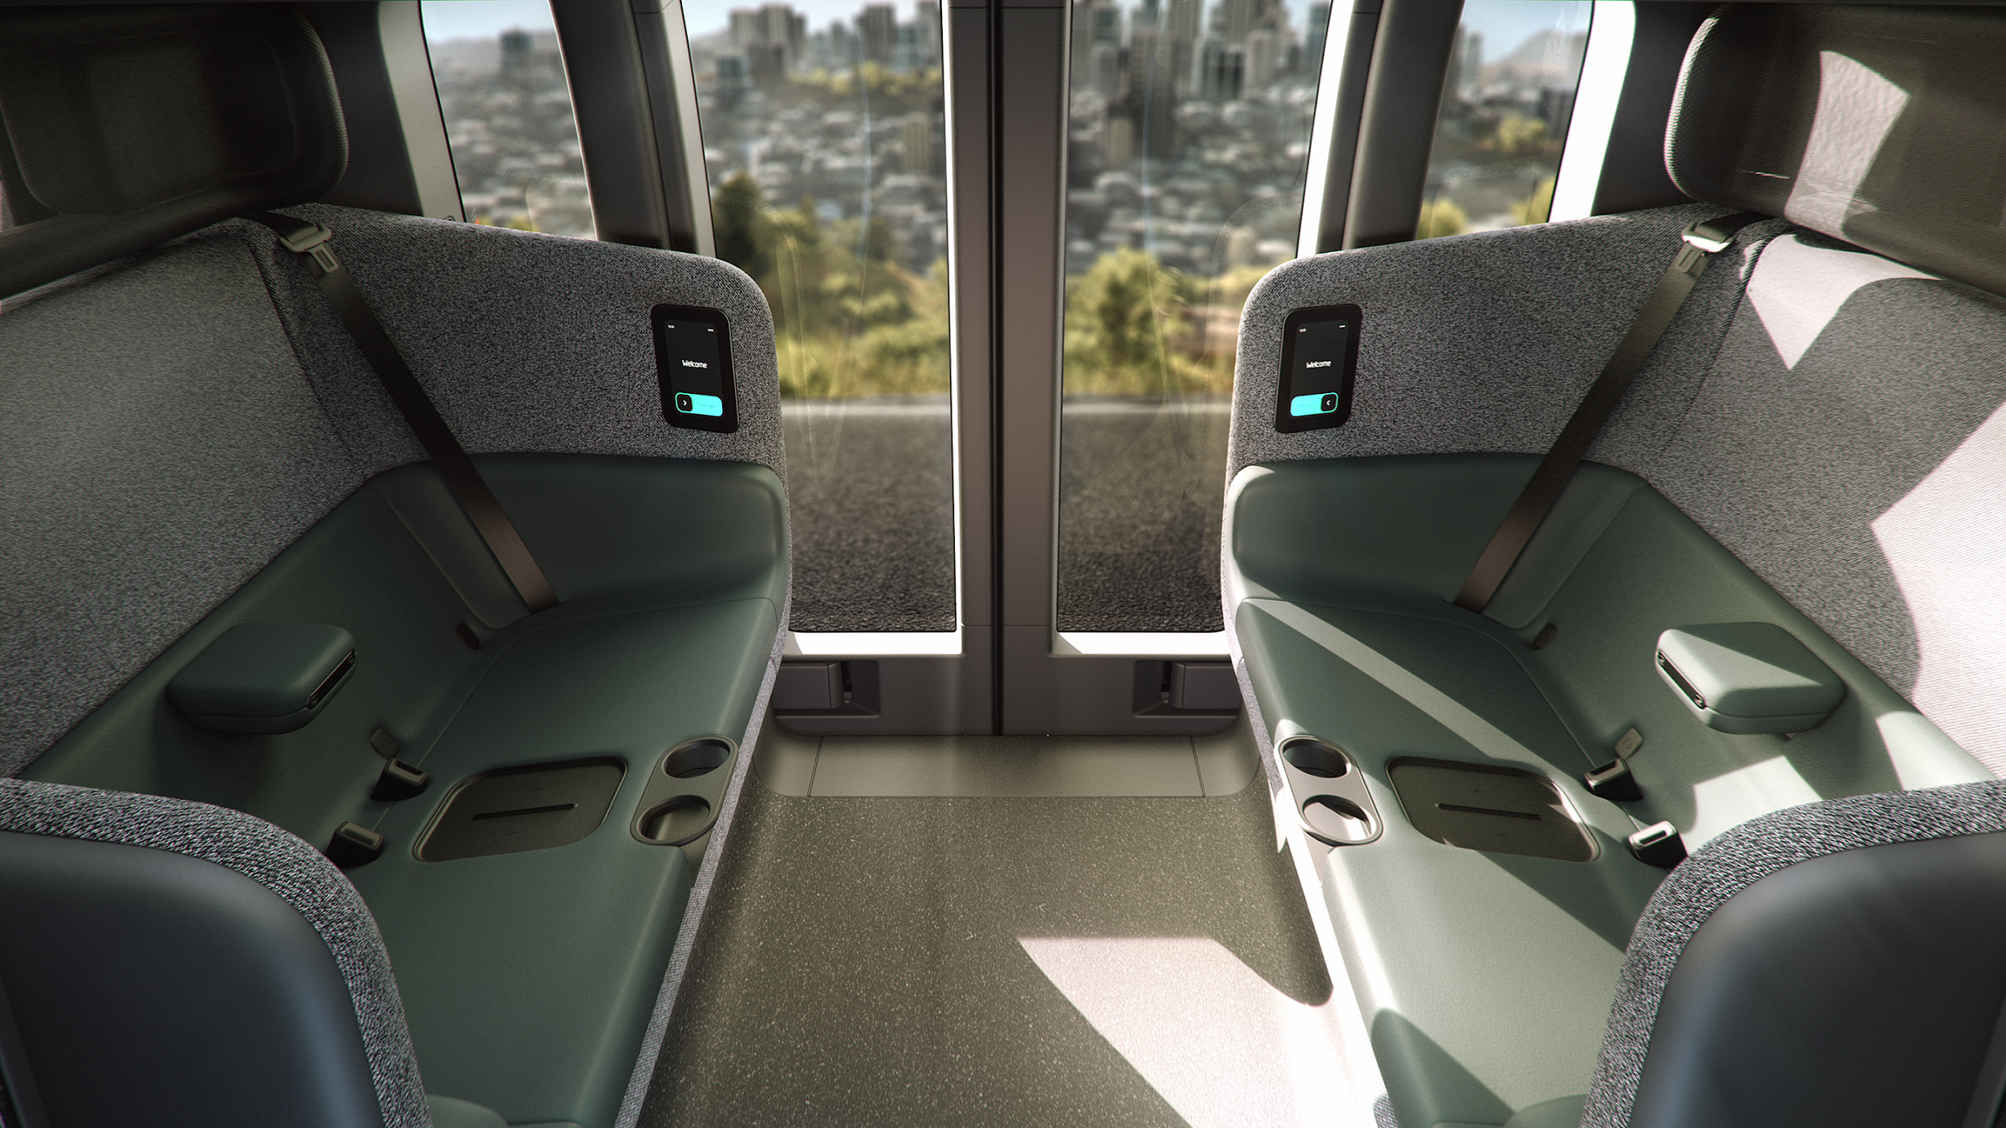
“Self-driving Shuttles” Also Being Tested
Shown: Zoox bi-directional shuttle
Notes:
Because regulations are largely performance standards rather than design requirements, sensor systems, cameras, software, features and appearance will vary among designs.
Another example of technology being evaluated in real-world use involves self-driving shuttles.
The Zoox vehicle shown is bidirectional, meaning it is fully operational driving either forward or rearward.
NEWS RELEASE LINK: https://www.globenewswire.com/news-release/2020/12/14/2144364/0/en/Zoox-Reveals-First-Look-at-Autonomous-Purpose-Built-Robotaxi.html
Restraint systems and other occupant protection features are important considerations as well. As we said earlier, crashes WILL occur for now.
ASK: How would riding in this vehicle impact discussions of front seat vs. rear seat? What about forward-facing vs. rear-facing child restraints?

Slide 23
What Guidance Is Needed by Families?
Clear Laws
(Current laws
focus on drivers)
Best Practice Guidance
(Using clear, consistent terminology)
CRS Product Regulations
Vehicle Design & Regulations
Notes:
As we look at ensuring safety, several aspects must be considered:
Clear Laws: Many parents look to and abide by laws as their only child passenger safety guidance. Forward-thinking statutes can help guide better, safer decisions.
Best Practice guidance: In addition to legislative requirements, educating caregivers on the safest ways to transport children in vehicles with new technologies is also important. One important consideration for such guidance is using clear and consistent terminology that caregivers understand. “Best practices” can supplement or precede laws, and revisions based on new knowledge can be adopted more quickly.
CRS Product Regulations: Car seats are regulated by stringent Federal requirements, giving families confidence that they are protective. Families need to have that same level of confidence when using new technologies.
Vehicle Design and Regulations: Similar to child restraints, families must also be confident in the safety of the technologies themselves.
In addition to following the car seat and vehicle instructions, some state laws and other policies may require certain types of restraint and also must be followed.

Slide 24
Appropriate Restraints for All Occupants
Notes:
It is important to understand several facts:
Crashes WILL continue to occur, so proper restraint remains important
In addition to collisions, evasive maneuvers like abrupt stops or swerves can cause considerable force.
Children are more vulnerable to being injured than other vehicle occupants.
Children are NOT scaled down versions of adults. Each growth stage needs specific developmental accommodations
Each of the 4 steps of restraint considers height, weight, age, development and available safety devices
Transitions to the next “step” should be delayed until reaching the height or weight maximum of the current step and the minimum height, weight and age of the next step
Unrestrained occupants are far more likely to be injured, and also have the potential to injure fellow occupants.

Slide 25
What do we know now?
Everyone in the vehicle must be properly restrained
Proper selection, installation & use of CRS are still required
Delayed transition to next restraint category encouraged
CRS away from frontal or other air bags with CRS warnings
Most are currently in front seating positions
New AV air bag designs may begin to appear in other positions
Vehicle seats must face front for add-on rear-facing, forward-facing and booster car seats
Car seat instructions must be followed
Vehicle manufacturer instructions must be followed for integrated restraint systems
Appropriate supervision is needed for children under 13
Rules could change as technologies evolve!
Notes:
Vehicle seats must face front for add-on rear-facing, forward-facing and booster car seats, based on today’s car seat designs and testing requirements.
Car seat instructions must be followed, including requirements for exclusive use on front-facing vehicle seats
Vehicle manufacturer instructions must be followed for integrated restraint systems, and may have specific seat configuration guidance when using integrated child restraints
NOTE: As vehicle, seating positions, air bags and other features evolve, they are likely to be accompanied by new rules for safe practices.
The next few slides will provide some additional detail on these topics.

Slide 26
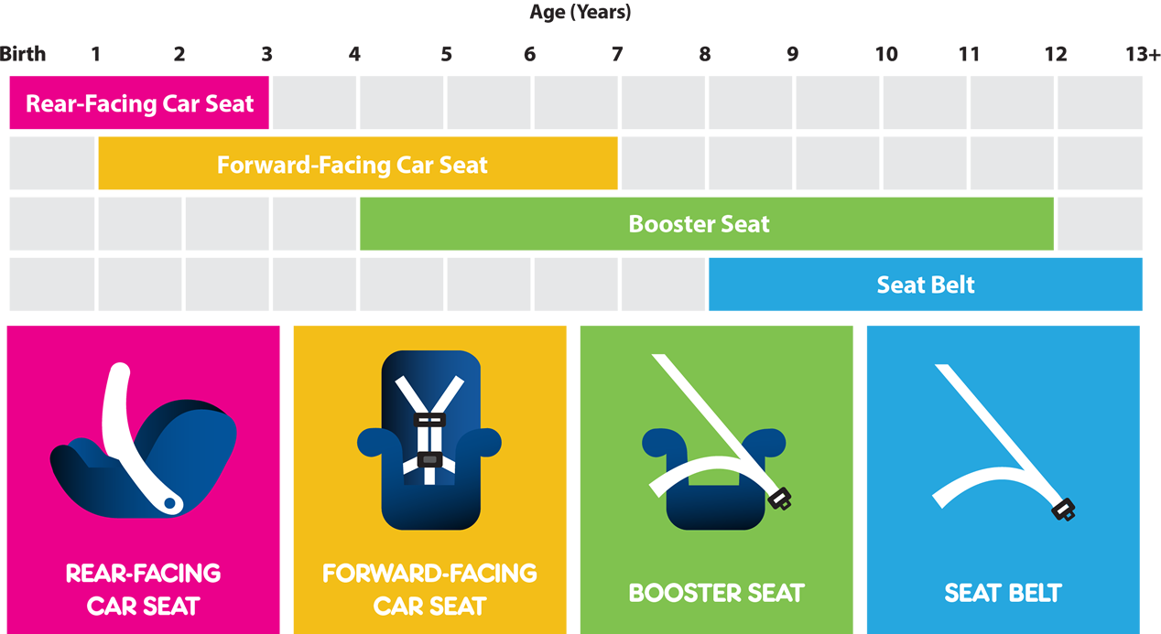
Proper Restraint for All Occupants
Notes:
The National Highway Traffic Safety Administration recommends 4 Steps of restraint and when they are appropriate, as their graphic illustrates. With that in mind:
Everyone in the vehicle must be properly restrained. Crashes, while reduced over time, will still occur for the
foreseeable future.
Proper selection, installation & use of CRS according to manufacturer instructions is crucial. These safety
devices are designed and tested to meet or exceed stringent standards and misuse may result in sub-optimal
protection.
Delayed advancement to next restraint category is encouraged by the NHTSA, the AAP, manufacturer
instructions and advocates.
State laws for child and adult restraint must be followed.
NHTSA 4 Steps Reference: https://www.nhtsa.gov/sites/nhtsa.dot.gov/files/documents/carseat-recommendations-for-children-by-age-size.pdf

Slide 27
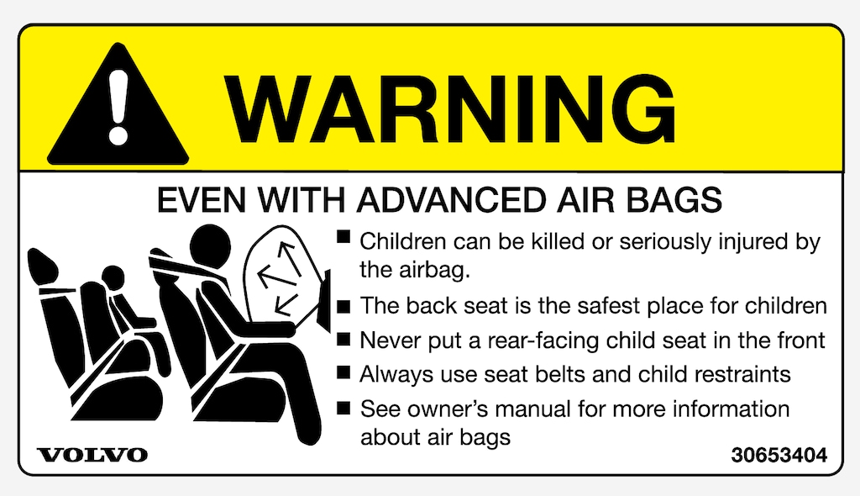
Follow Air Bag Warnings
Notes:
In general, young children and car seats must be in seating positions away from frontal or other air bags with CRS warnings
Rear-facing child restraints MUST NOT be placed in seating positions with active frontal air bags
The currently accepted best practice is that children under age 13 should be seated away from frontal or other air bags with warnings.
Frontal air bags are currently in front seating positions, but new air bag designs may expand to other positions as vehicles evolve.
AVs may have novel types of air bag designs, which should be evaluated for child safety.

Slide 28
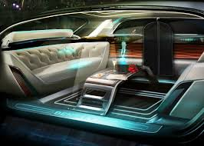
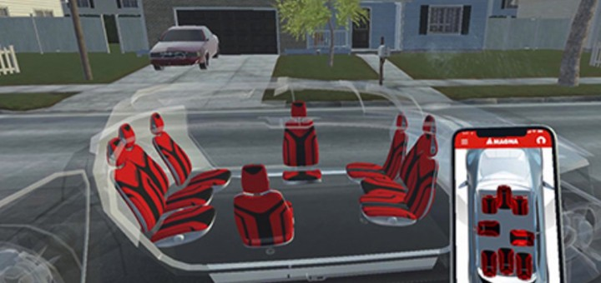
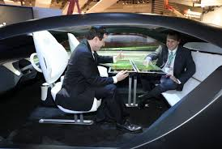
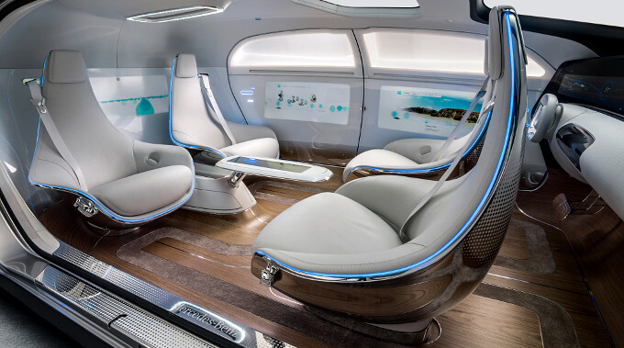
Interior: Seating Possibilities
Notes:
As we move toward vehicles that are more autonomous, seating configurations will have more options.
Remember that in fully automated models, all occupants become passengers so varied configurations will be available
NOTE: FMVSS 213 testing, which regulates car seats for safety, is based exclusively on front-facing vehicle seat simulations
Rear, side or oblique-facing vehicle seats will not be appropriate for current car seat designs, since their safety is dependent on current testing requirements.
The concept of rear-facing and forward- facing may become more challenging to communicate as dual direction vehicles are introduced (vehicles that do not truly have front or rear ends)

Slide 29
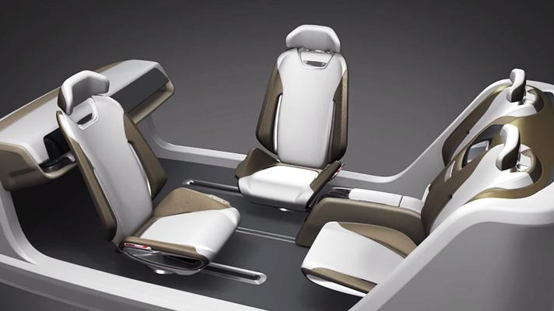
AV: Family Choices in Seating & Activities
Notes:
Recent international research showed that more consumers would currently prefer a traditional front-facing seating configuration
Sjaan Koppel, Jesús Jiménez Octavio, Katarina Bohman, David Logan, Wassim Raphael, Leonardo Quintana Jimenez & Francisco Lopez-Valdes (2019) Seating configuration and position preferences in fully automated vehicles, Traffic Injury Prevention, 20:sup2, S103-S109, DOI: 10.1080/15389588.2019.1625336
The study also showed that participants’ preferences varied, however, so instructional, mechanical and legislative guidance will be necessary.
Since parental conveniences are often at odds with safety “best practices,” consumer preferences and behaviors continue to be studied.
It is likely that seating configurations will be more flexible than they are today - allowing for both traditional and nontraditional adjustment.

Slide 30
Vehicle Seats Must Face Forward for CRS
Notes:
Vehicle seats must face front for any current, add-on rear-facing, forward-facing and belt-positioning booster car seats
The top left image represents the front-facing test bench that is used for compliance with Federal standards. The simulated bench seat faces front for required car seat compliance.
The bottom right image is an example of common requirements in car seat instructions: “Use the child restraint only on vehicle seats that face forward.”
Car seat instructions and vehicle restraint instructions must be followed, including requirements for exclusive use on front-facing vehicle seats
Vehicle manufacturer instructions must be followed for integrated restraint systems, and may have specific seat configuration guidance when using integrated child restraints

Slide 31
Children Must Be Supervised for Safety
Current vehicles and laws make the driver or attending parent responsible for child safety
Who is responsible when the potential exists for no parent/caregiver to be present or alert?
children may unbuckle themselves or others
bored children may play unsafely with unused seat belts
What is the appropriate age when a child can ride alone?
Children under 13 must not be transported
without appropriate adult supervision.
Notes:
As our vehicle fleets become more autonomous, questions about where responsibility resides do not have firm answers.
We know, however, that young children cannot be held fully responsible for their own safety. Supervision is a must.
Experts on the Blue Ribbon Panel and the Consortium agree that children under age 13 must be supervised to ensure their safety
In addition to education and instructions, legislation and other policies are important and will be discussed on additional slides

Slide 32
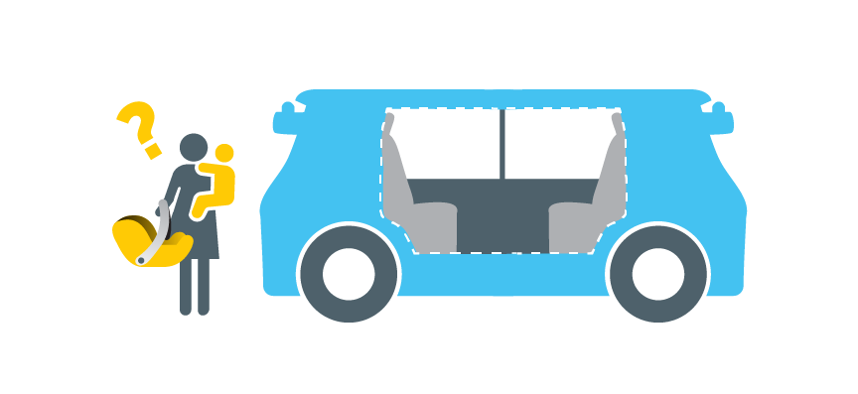
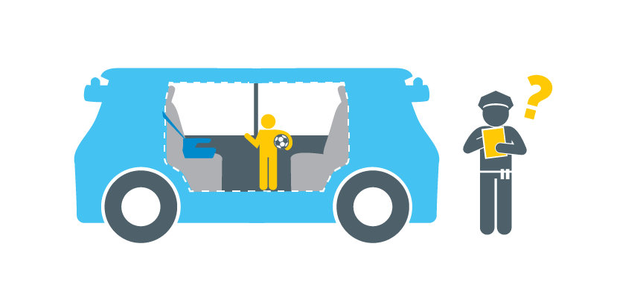
AV: Time Efficiency Discussion
What are some potential benefits to families being “driven” compared with an adult needing to drive?
What are some of the related safety considerations?
Safety vs. Convenience
Notes:
SAFETY VS CONVENIENCE CLASS DISCUSSION
PRESENTER NOTE: If you need to get the conversation started, the below are some example thoughts:
Unproductive time can be reduced if all occupants are passengers.
This significant amount of time can be spent more productively.
There may also be advantages to community infrastructure. Shared vehicles (AV rideshare, commercial shuttles, delivery vehicles, etc. may not require parking space if they are used more extensively than privately owned vehicles.)
Furthermore, there may be relationship benefits for families who share ride time.
Safety considerations include:
using car seats and seat belts
correct restraint selection, orientation, installation and use
following child restraint and vehicle manufacturer instructions for vehicle seat orientation
appropriate adult supervision for children under age 13

Slide 33
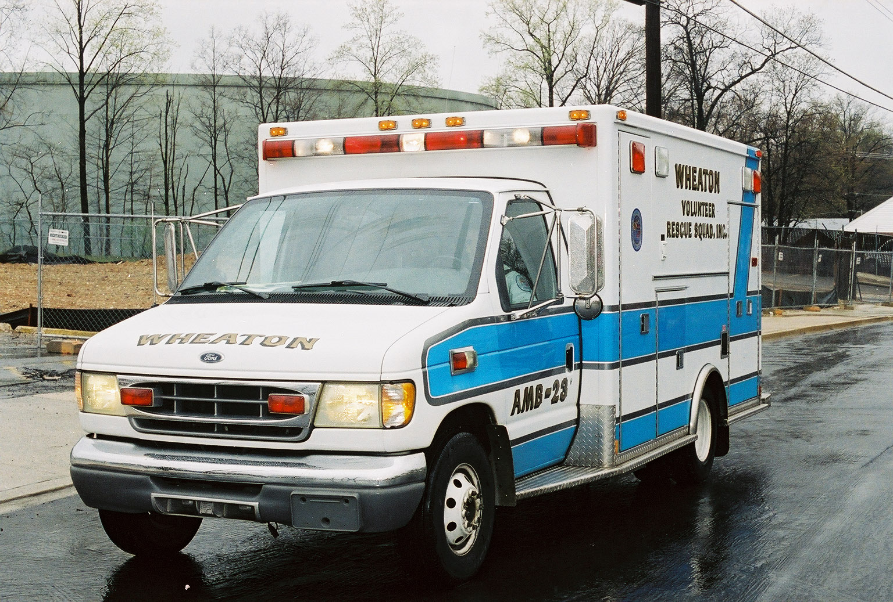
EMS Possibilities
Fewer crashes and significant injury reduction
Benefits for emergency vehicles
Collision avoidance technologies
Features for braking, parking, etc.
Communicate with other vehicles
Less divided attention for patients
Rideshare for non-emergent transport
Who is responsible for patient-care decisions?
Will any AV systems require special deactivation training?
Notes:
We have already discussed driver assistance features and self-driving technologies are expected to reduce the number of crashes and related injuries by removing the potential for human error.
Collision avoidance technology and smart vehicle features are likely to become part of the electronics built into emergency vehicles.
This could reduce the frequency of crashes between ambulances and passenger vehicles.
Communicating with other vehicles on the road is another potential benefit. Waymo, for example, has patented a system that will allow their vehicles to detect emergency vehicles by their lights and sirens and automatically pull over.
Assistive technologies may also allow medics to focus more attention on patient care than the emergency transport.
Rideshare services may supplement emergency vehicles for non-emergent patient transport.
EMS must assure that these advancements allow seamless response and care
Advocate for supervision requirement
Restraint requirements and monitoring
Any technological needs (as we have seen with airbag dangers and disconnection)
ASK: What other benefits might there be for 1st responders? What other issues may 1st responders face?

Slide 34
Law Enforcement and AV
Fewer crashes and significant injury reduction
Human error crashes
Distracted driver crashes
Impaired driver crashes
Officers multitask in patrol vehicles
Did the driver assume emergency control in a Level 2 or 3 vehicle?
Who is responsible for crashes in vehicles with no driver?
Have laws been updated to include autonomous vehicles?
Notes:
The most significant law enforcement benefit is reducing the likelihood of crashes.
Human error will be reduced
Distracted driving will be less concerning with advanced technologies
Driverless vehicles can eliminate impaired driver crashes
Officer crashes can be reduced as appropriate features are built into patrol vehicles (and officer distractions are removed)
There will be some challenges, so law enforcement needs to be represented. Questions include:
- How was each passenger restrained, including the restraint category, orientation and usage?
- Did the driver assume emergency control in a Level 2 or 3 vehicle?
- Who is responsible for crashes in vehicles with no driver?
- Have laws been updated to include autonomous vehicles?
In addition, special training and familiarity may be required to determine the causes of crashes (human error, equipment failure, software failure, etc.)
ASK: What other benefits might there be for law enforcement? What other issues might officers face?

Slide 35
Laws Must Guide Safe Practices
Model Law for Child Transport in AV
Responsible party duties
Supervision requirements
Restraint requirements
Vehicle requirements
Definitions
In addition to requiring compliance, usage laws
are a crucial part of educating road users.
Notes:
In addition to requiring compliance, usage laws are a crucial part of educating road users.
Based on experience with car seat and other vehicle usage laws, many families look to the law as defining safe practices, so these laws must be be complete and represent the products on the market.
The experts in the Autonomous Vehicles Consortium have developed model guidance for state legislatures to consider. Visit www.safekids.org/AV
State laws and other policies must consider and address several areas to ensure safety.
Since we have expertise that not all state legislatures have in place, this model law can help assure that important areas are addressed.
Considerations must be brought to legislator attention.

Slide 36
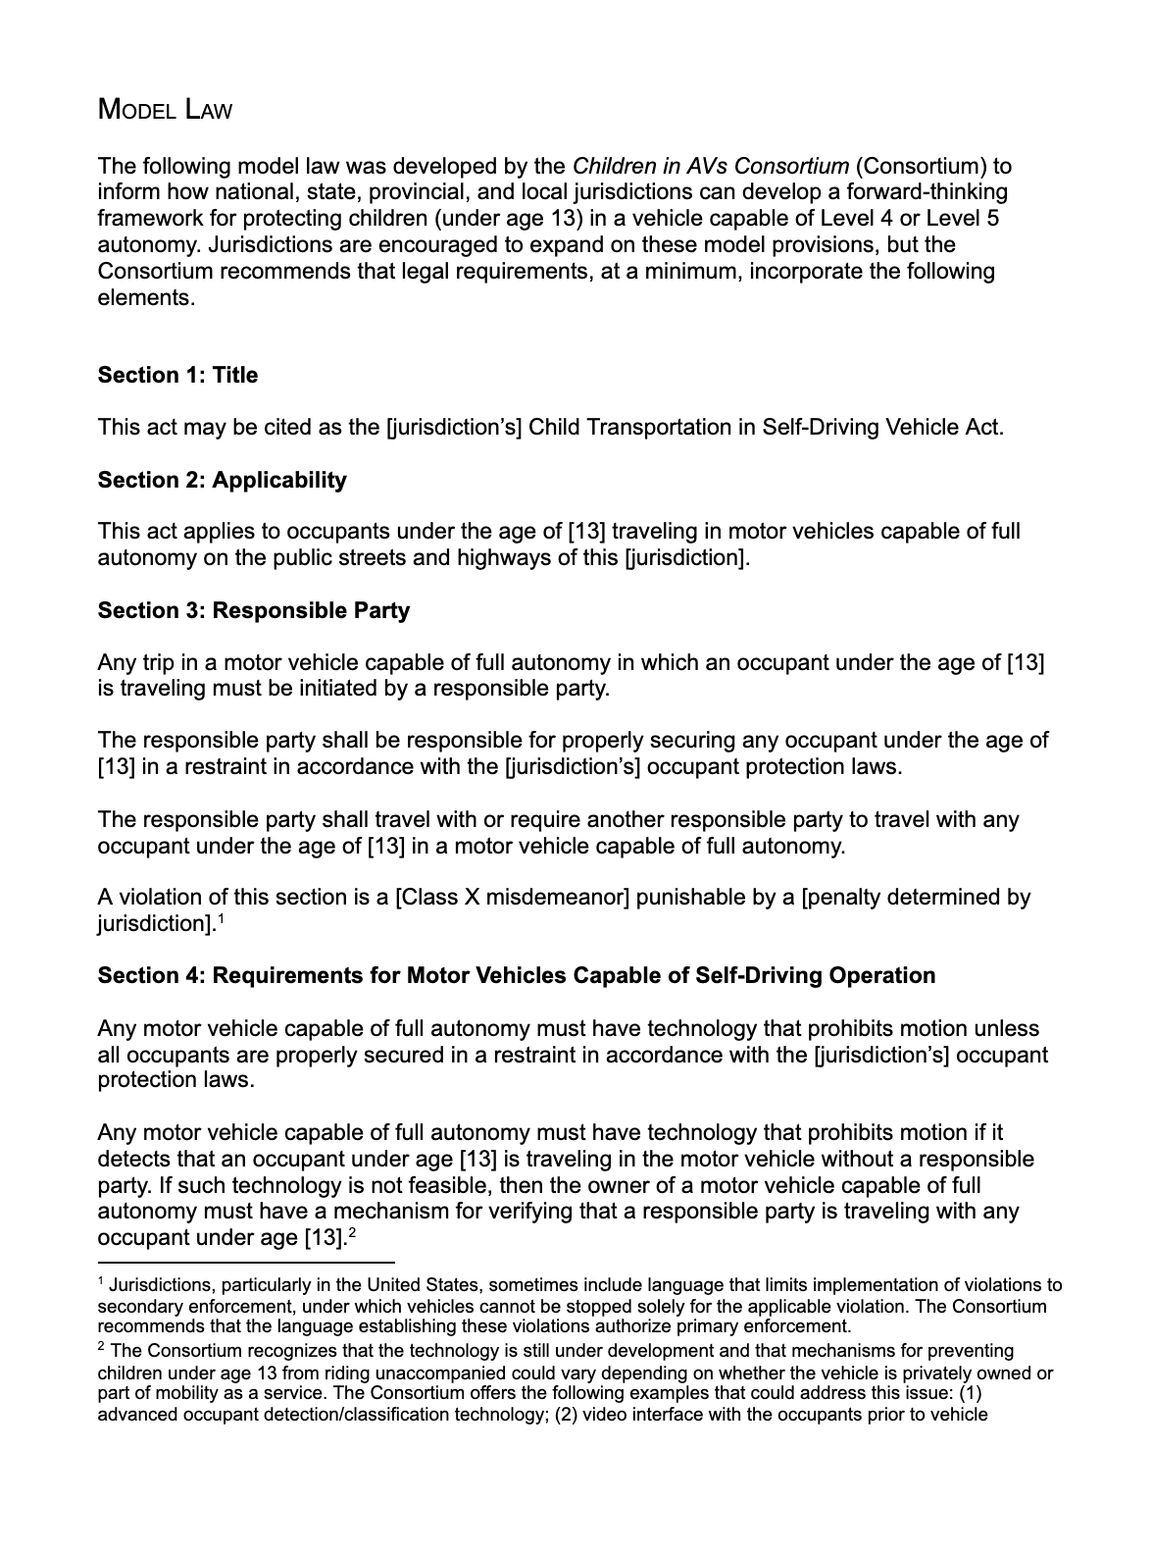
Model Law for State Use
Applies to children under 13
Requires that a responsible party be present
Requires restraint use
Requires technological verification of compliance
Provides definitions for state consistency
Notes:
The image you see is the front page of the model law, and the full law can be downloaded here:
(direct download at www.safekids.org/AVs for model law – and double check to be sure the model law image is the most current)
While the law wording goes into more detail, topics addressed include:
Expectations for responsible parties
Requirement that children under 13 are supervised
Requirement that all occupants must be properly restrained
Requirement for autonomous vehicles carrying children to “sense and notify” if a child is unrestrained
Definitions that are specific to this law and the technology it includes
NOTE: This model law is designed to supplement other vehicle and restraint requirements, which vary by state. It does not replace existing policies.

Slide 37
Design & Regulatory Considerations
Notes:
As vehicles become more autonomous, children must not be an afterthought!
Communicating relevant information to designers, developers, regulators and marketers is a crucial role of Consortium members.
The next several slides look at that from a safety perspective.

Slide 38
Safe Kids Worldwide’s AV Efforts
2015
2017
2019
2021
Recognizes no kids in AV media
Develops expert Panel to set guidance and best practice; GM provides seed money
Launches Consortium to develop GUIDANCE per Panel recommendations (18 month)
Launch Kids in AVs Interest Group
Consortium releases
tool kit
Presentations and
webinars begin
Questions how kids in AV are to be safe: research, design, development, testing and marketing
Convenes Blue Ribbon Panel of high level child and traffic safety experts; report has 5 Calls to Action and 8 Recommendations
Progress from WGs
Activate Kids in AVs Interest Group surveys/communication
COVID-19 Effects
2016
2018
2020
Notes:
Safe Kids Worldwide Involvement in AV activities:
As mentioned, assisted driving features have been in development and use since the 1950s and advanced assistance features since the early 2000s.
Child safety advocate involvement has been comparatively recent, and is becoming more robust.
As new research and other information become available, advocate involvement is crucial.
We must ensure that child safety is on the table at every stage of development, regulation, legislation and education.

Slide 39
CPS Techs Need Updated Info
2017 survey: 1300 certified CPS Technicians
131 actively following and 811 “know a little” about AV
975 have never started a conversation about AV
Child supervision (1005) is the biggest AV concern
Believe AV is in distant future
AV design & development have been progressing for decades, but widespread visibility is now increasing
Notes:
Part of the process for of advocacy is raising awareness within its own ranks.
Individuals across the USA and extending to other countries are certified Child Passenger Safety Technicians.
These technicians play an important role in educating families on safe “best practices” and interacting with those families to identify and resolve issues.
CPS Techs also play a role in communicating issues to manufacturers and regulators while encouraging the families they work with to do the same.
Another key communication goal of the Consortium is to appropriately convey safety issues and practices to and through this network of educators.

Slide 40
What do CPS Advocates Need to Know?
Advocates play an important role in family education
Restraint use for all
Car seat selection, installation and use
Air bag interaction and warnings
Supervision for children under age 13
Advocates can also play a role in state legislation.
Familiarity with basic vehicle features is important.
Vehicle owner’s manuals and online resources must be consulted.
Notes:
Child passenger safety advocates, including technicians and instructors, have an important role in the educational process.
As new technologies evolve, there will likely be additional variables for caregivers to consider.
Restraints:
Crashes can and will occur, so proper restraint remains important
Currently available child restraints may only be used on vehicle seats that face forward, as they do in the vehicles of today.
- If future systems are developed for nontraditional seating, the car seat and vehicle instructions must be followed.
The 4 steps of restraint must be followed, delaying transitions for as long as manufacturer instructions allow.
Car seats will still be required to have installation processes for seat belts as well as LATCH.
Tethers should be used for forward-facing car seats, whether installed with seat belts or lower anchors.
All manufacturer instructions (car seat and vehicle) must be followed, along with state law requirements.
Vehicle instructions must be followed for integrated (built-in) restraint systems
Air bags:
Children should be positioned away from active frontal air bags, as required or recommended by vehicle and car seat instructions.
Rear-facing car seats must never be used in seating positions with active frontal air bags
As air bags evolve and are added to more seating positions, instructions and warnings must be followed.
Supervision:
While driverless vehicles may allow for unlicensed users to travel, children need supervision to ensure their safety.
Children under age 13 must travel with a mature caregiver to monitor restraint use, behavior and other choices.
Our model law requires supervision by an adult age 18 or older.
ASK: Can you think of other questions caregivers may have, or situations that may require specialized education?

Slide 41
Child Safety at the Forefront
AV Developers, Vehicle Manufacturers, Car Seat Manufacturers, Regulators and Safety Experts… MUST COMMUNICATE THROUGHOUT PROCESS!
Notes:
As advanced assisted driving and autonomous vehicle features expand and evolve, it is crucial that developers, vehicle manufacturers, car seat manufacturers, regulators, safety experts and advocates communicate.
One recent example where that did not occur as well as it should have is related to air bags:
the technology was being developed and tested for over 30 years before frontal air bags were mandated in the mid-1990s
air bags were seen as a way to reduce motor vehicle injuries and fatalities
The early devices could hurt or kill children who were in front seats in either rear-facing car seats or not properly seated and restrained at all
over 120 children were killed
In response:
education changed: kids ride in rear seats
some state laws changed, requiring rear seat placement for young children
instructions and labels were added to car seats and in vehicles regarding the potential danger that air bags pose to young children
technology changed with depowered air bags and eventually advanced air bags that deactivate if a child is seated in that position
By communicating about emerging features NOW, we can plan and prepare for child safety rather than risking injuries and then responding!

Slide 42
Will Common Crash Types Shift?
Will frontal crashes continue to be the most common type?
Regulatory and Testing Consideration in the United States:
FMVSS 213 requires frontal crash protection for car seats
Near-side lateral testing is anticipated
No rear or rollover testing is required
Notes:
One significant concept is that crashes WILL occur as we transition to more advanced technologies.
Current car seat regulations reflect the most common crashes for manually driven vehicles and therefore simulates frontal crashes on simulated vehicle seats that face the front of the vehicle. While research testing and field data includes other types of crashes, current regulations do not.
What we don’t know is how the nature of crashes and the commonality of certain crash types may shift.
Will the most common crashes be different for users of autonomous vehicles?
Are self-driving vehicles more likely to be striking (frontal) or struck (additional crash types)?
Many of our current standards for protecting vehicle drivers and passengers are based on frontal crashes, for example. That is because frontal crashes are the most common type of crash. These occur when a vehicle strikes something (other vehicle, stationary object, etc.).
To put that in perspective, a 2-vehicle rear-end crash is a frontal crash for the striking vehicle. Likewise a 2-vehicle T-bone (lateral) crash is a frontal crash for the striking vehicle.
This is just one example of why communication among the mentioned groups is crucial for ensuring child safety.

Slide 43
Example AV Child Safety Considerations
Seat Configuration
Require front-facing seat for CR use?
Can directional misuse be mechanically prevented?
Instruction label on vehicle seats or belts?
Labels for booster seat use facing front?
Mechanical block to force compliance?
Compatibility
Differences in lower or tether anchors?
Differences in air bags?
Other
Front seat installation?
Potential crash interaction among occupants?
How will bi-directional vehicles address CRs?
Notes:
In addition, other design considerations regarding children will also be useful.
Seat Configuration
Seat configurations may be adjustable, but car seat testing uses vehicle seat simulators that face forward.
Should instructions require vehicle seats to face front for child restraint installation and use use?
Should there be instructional labels on vehicle seats or belts?
Should that also apply to booster seats since child restraint manufacturers require it?
Can mechanical designs block child restraint installation when vehicle seats are not properly oriented to force compliance?
Compatibility
Will seat belts with rigid buckles allow for the proper installation of current and future car seat models?
Do we foresee necessary differences in lower anchors or tether anchors to accommodate new seating designs?
Will new air bag designs negatively interact with certain child restraints
Other
Driverless vehicles may not have a clear differentiation for front versus rear seats. Will car seats be allowed on the forward-most vehicle seats?
Will new seating configurations and restraint types allow for interaction among occupants during crash events?
Dual-directional vehicles travel either forward or backward, so rear-facing and forward-facing CRs are less clear.
This is NOT an exhaustive list!
Each of these unknown items represents an opportunity for proactive consideration for industry, legislative and educational standards.
Some must be addressed through education or legislation, while others can be addressed through mechanical processes and regulation.
ASK: What other considerations might there be for future regulations, instructions and “best practices”?

Slide 44
Safety Is Important for All Uses
Multiple User Vehicles Becoming More Common
Rideshare, rentals, shared vehicles
Certain car seats are becoming more portable, lightweight
Easy use, accessible instructions and dexterity are needed
Labels—pictorial
Standardized, harmonized terms for a new field
10 years ago, no one talked about GOOGLING, for example
Vehicle Differences – Cars, trucks, shuttles
Interior designs
Swivel seats
Number of rows and configurations
Notes:
In addition to common vehicle uses today, we must consider the variety of uses that is likely to evolve:
In addition to personal vehicles, autonomous vehicles will likely be used in many other ways, and safe equipment and use is crucial.
When discussing car seats, we must consider a significant shift from installing them once for an extended period to frequently moving and reinstalling them.
As we consider shifts from exclusive vehicle ownership by families to multiple-user vehicles (rideshare, rentals, shared ownership, etc.):
Car seats will also continue to evolve:
Certain car seat models may become more portable and lightweight
Correct installation needs to be even more easily understood and achieved for more frequent installation
Labels and pictorial instructions may be more important to that process, since they are easily accessed and understood
Consistent Terminology:
To educate consumers on correct use, appropriate and consistent terminology in marketing, instructions, legislation and other resources is important.
Reading and comprehension levels must also be considered, along with additional languages.
By using standardized terminology to describe new concepts, vocabulary expands and new meanings are understood.
New terms must be understood - While most of us are more familiar with the concept of “Googling” for example, that was not the case a decade ago.
Vehicles Will Vary Significantly:
Even with common terminology, there will be differences in application due to differences in vehicles.
Agreeing to use standardized terms in marketing, instructions, legislation, research and regulations will help minimize misunderstanding.

Slide 45
Marketing & Media Must Be Consistent
Notes:
In addition to terminology, visually representing vehicles with the newest technologies safely is crucial.
This image shows that we have a lot of work to do to influence how kids and parents in AVs are represented.
The image is from when a national magazine publicized our Blue Ribbon Panel report in 2018.
It shows an uninterested adult and unrestrained kids hanging out a window.
Consistency among internal communications teams, media and other communication outlets, and web representations is essential to safety.
All stakeholders must commit to ensuring that children are represented in car seats and seat belts following best practices, as we have done and continue to do to enhance child passenger safety education for many years.

Slide 46
Additional Resources
Policy, Legislation & Enforcement
Guidance and best practices for ensuring policies and legislation include children
2021
The Autonomous Vehicles Consortium is creating, publishing and adding resources
Public Information & Education
Educational information useful for consumers, certified CPS techs, 1st responders, and law enforcement officers
www.safekids.org/AVs
Notes:
The Autonomous Vehicles Consortium now has a web page full of useful information and links
URL: www.safekids.org/AVs
By design, the Consortium focused on two large categories of information:
The Policy, Legislation & Enforcement group focused on providing information useful to developing policies.
The Public Information & Education group focused on information that is useful to AV users and the general public
Information from both groups is available and will be added to as more information becomes available
In addition, Consortium members are actively seeking additional opportunities to communicate and provide education.
NOTE TO SAFE KIDS ORGANIZERS:
We suggest that the website should include categorical links:
GENERAL – BRP and Consortium reports, webinars, promotional videos, appropriate links, etc.
FOR EDUCATORS – Presentation, guidance for using presentations, model law, links to key developer stakeholders, other appropriate links, etc.
FOR DEVELOPERS – Resources from Policy, Legislation and Enforcement WG, links to key developer stakeholders, links to NHTSA regulatory activities, etc.
A few links to include in global list are:
https://pavecampaign.org/
https://www.ltad.com/
https://www.iihs.org/topics/advanced-driver-assistance
https://www.nhtsa.gov/es/vehicle-manufacturers/automated-driving-systems

Slide 47
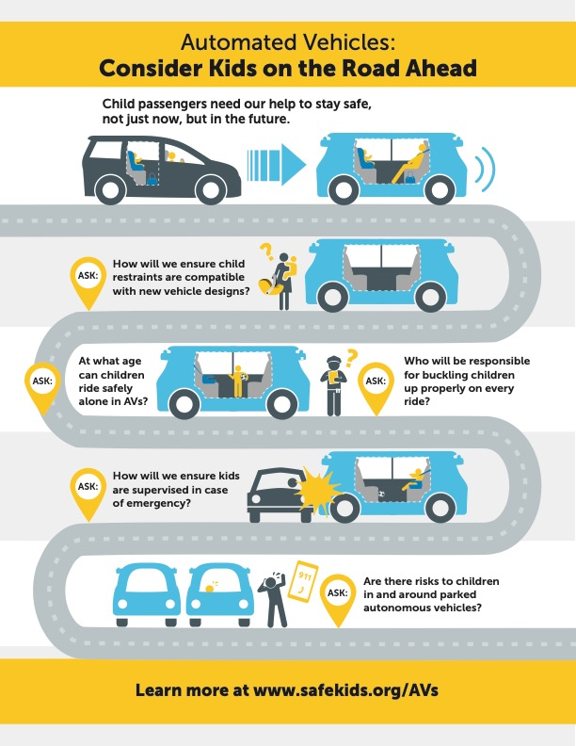
Get Involved & Stay Updated
Online Toolkit:
Presentations
Webinars
Useful information
Links to additional information sources
www.safekids.org/AVs
Join our Autonomous Vehicles Interest Group:
New information will be communicated
Opportunities for input
Educational resources
www.safekids.org/AVs
Notes:
In addition to common vehicle uses today, we must consider the variety of uses that is likely to evolve:
In addition to personal vehicles, autonomous vehicles will likely be used in many other ways, and safe equipment and use is crucial.
When discussing car seats, we must consider a significant shift from installing them once for an extended period to frequently moving and reinstalling them.
As we consider shifts from exclusive vehicle ownership by families to multiple-user vehicles (rideshare, rentals, shared ownership, etc.):
Car seats will also continue to evolve:
Certain car seat models may become more portable and lightweight
Correct installation needs to be even more easily understood and achieved for more frequent installation
Labels and pictorial instructions may be more important to that process, since they are easily accessed and understood
Consistent Terminology:
To educate consumers on correct use, appropriate and consistent terminology in marketing, instructions, legislation and other resources is important.
Reading and comprehension levels must also be considered, along with additional languages.
By using standardized terminology to describe new concepts, vocabulary expands and new meanings are understood.
New terms must be understood - While most of us are more familiar with the concept of “Googling” for example, that was not the case a decade ago.
Vehicles Will Vary Significantly:
Even with common terminology, there will be differences in application due to differences in vehicles.
Agreeing to use standardized terms in marketing, instructions, legislation, research and regulations will help minimize misunderstanding.

Slide 48
Questions?
www.safekids.org/AVs
Notes:
Thank you for participating today.
Please visit www.safekids.org/AVs for additional information, resources and updates
ASK: Is there anything I can add, clarify or answer?

