Slide 1
Never Leave a Child Alone in a Car Child Care Provider Presentation
Working together to raise awareness and save lives.

Slide 2
As of March 1, 2020
San Jose State University
www.noheatstroke.org
Notes:
In the past two years over 100 children have died with a total of 845 since 1998
Cases are on the rise and childcare centers are indirectly or directly involved in nearly 50 percent of these cases
The data provided within this presentation comes from Golden Gate Weather from 1998 to present

Slide 3
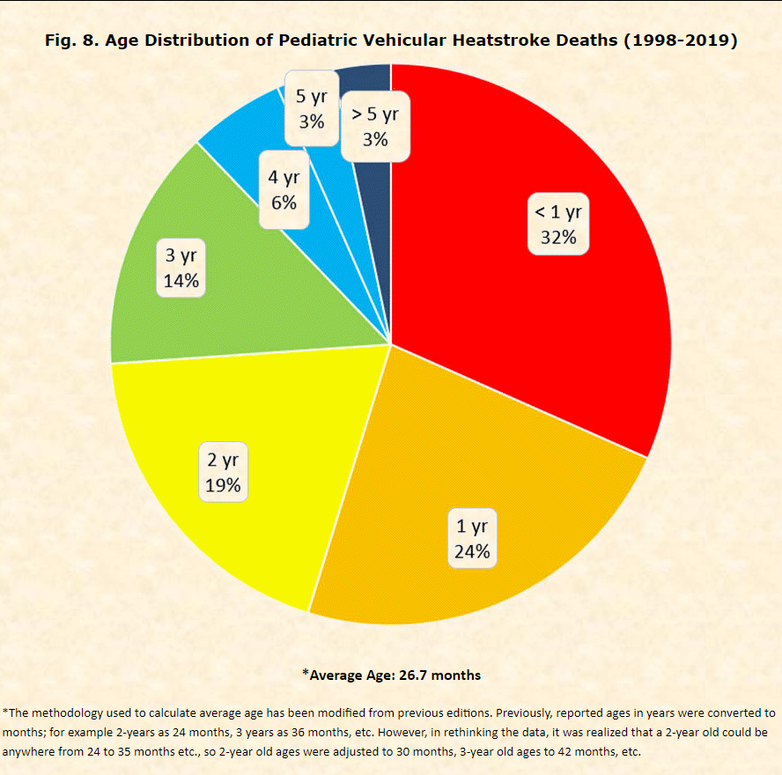
89% of fatalities happen to children under 4 years of age
.
San Jose State University
www.noheatstroke.org
Notes:
89% of the fatalities were children under age 4; preschool/childcare age. Infants make up over half of the fatalities.

Slide 4
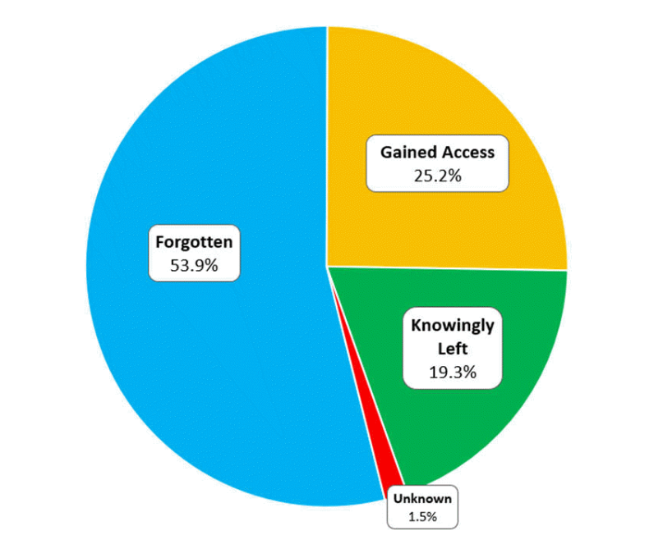
Circumstances Resulting in Heatstroke Deaths of Children in Vehicles
100% Preventable
79% Unintentional
San Jose State University
www.noheatstroke.org
Notes:
This is 100% preventable with the help of bystanders

Slide 5
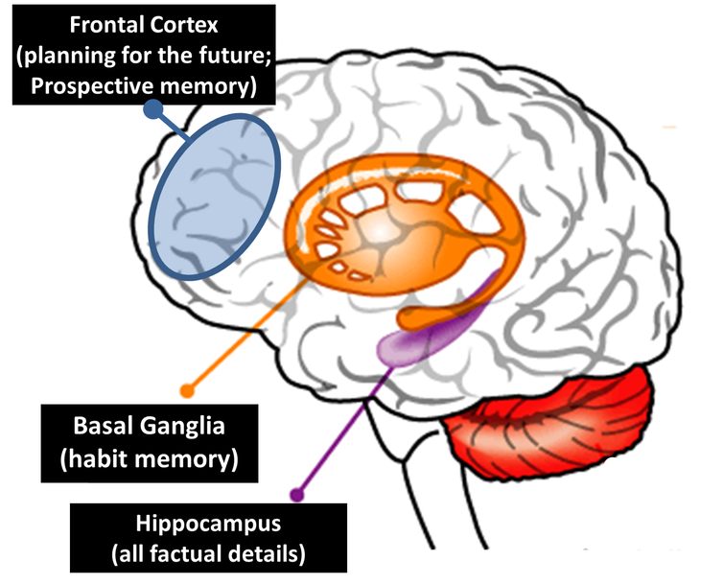
How can a child be forgotten in a vehicle? It can happen to ANYONE, EVEN YOU!
Two Types of Memory:
Prospective Memory - the here and now, storage of new information, conscious decision making
Habit Memory - “autopilot”, doing things that are routine without thinking about it, turns on automatically without a conscious decision to do so
Dr. Diamond https://bit.ly/28MGZgp
Kids and Cars
Notes:
Slide by Janette Fennell – Kids and Cars
If you are sitting back thinking “how could a parent forget their child” “that would NEVER happen to me”. Think again. This happens to professionals, doctors, lawyers, school teachers and first responders. It happens to nearly 54% of children.
There is a physical reason how this happens: Please read to be able to explain to the group; Dr. Diamond https://bit.ly/28MGZgp

Slide 6
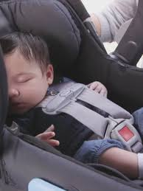
46% of “Forgotten” were on their way
to Childcare/Preschool

Slide 7
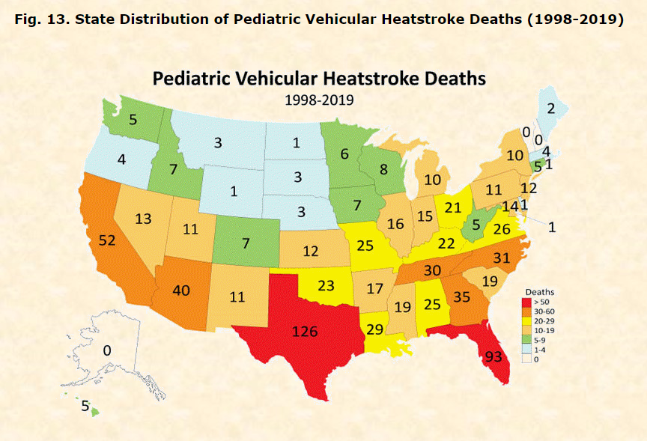
San Jose State University
www.noheatstroke.org
Notes:
Fatalities have been recorded in 47 states and the District of Columbia.

Slide 8
The Issue
Leading cause of non-crash, vehicle-related deaths for children.
A car can heat up 19 degrees in 10 minutes. And cracking a window doesn’t help.
The body isn’t able to cool itself quickly enough.
Young children are particularly at risk – bodies heat up three to five times faster than an adult’s.
When internal temperature gets to 104 degrees, major organs begin to shut down. At 107 degrees, the child can die.
San Jose State University
www.noheatstroke.org
Notes:
Why is it important for a person to take action and call 911 immediately?
Children left alone in a car is the #1 danger regardless of temperature . With the momentum that you generated last year it continued into the cooler months. I received countless google alerts of bystanders taking action and calling 911 this winter. I believe the message was clear, regardless of temperature, a child should never be left alone in a car, not for a minute.
Even on a mild day, the inside of a car can quickly become very hot. That’s especially dangerous for kids:
a child’s body heats up 3-5 times faster than an adult body.
Temperatures inside a car can rise 19 degrees in 10 minutes.
Leaving a window slightly open has no effect on the inside temperature of a vehicle.
Heatstroke occurs when the body isn’t able to cool itself quickly enough and the body temperature rises to dangerous levels.
Young children are particularly vulnerable since their internal systems to regulate body temperature are not fully developed – there is little margin for error.
When the body temperature reaches 104 degrees, the internal organs start to shut down. When it reaches 107 degrees, the person dies.
Symptoms can quickly progress from flushed, dry skin and vomiting to seizures, organ failure or death.
A person doesn’t know how long the child has been in the car and every minute counts.
One doesn’t know how long a child has been unattended in the car and time plays a critical factor when heatstroke is involved and with safety overall.

Slide 9
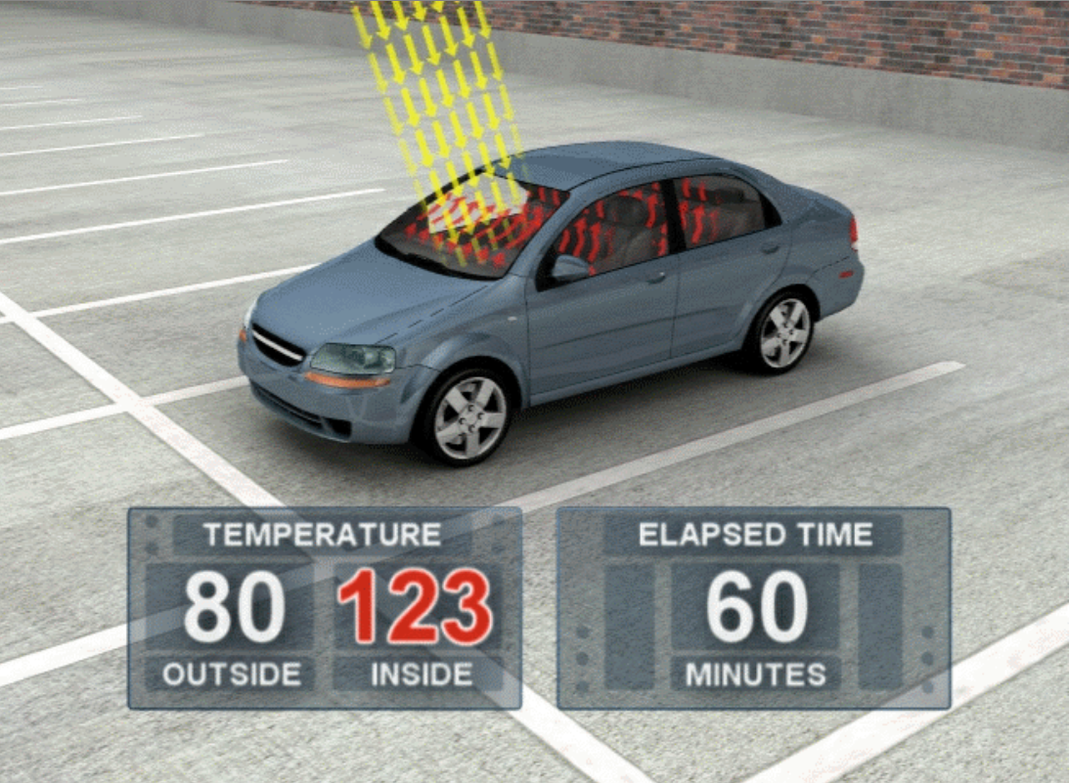
Vehicles Can Heat Up 19 degrees in 10 minutes
Studied temperature rise in enclosed cars on 16 dates between May 16 and Aug. 8, 2002. (see graph of 16 case days) Ambient temperature were between 72 and 96 degrees F Dark Blue mid-size sedan with medium grey interior Also tested with windows “cracked”
Right Click – “Open Link”
Animation courtesy of General Motors and Jan Null, San Jose State University
San Jose State University
www.noheatstroke.org

Slide 10
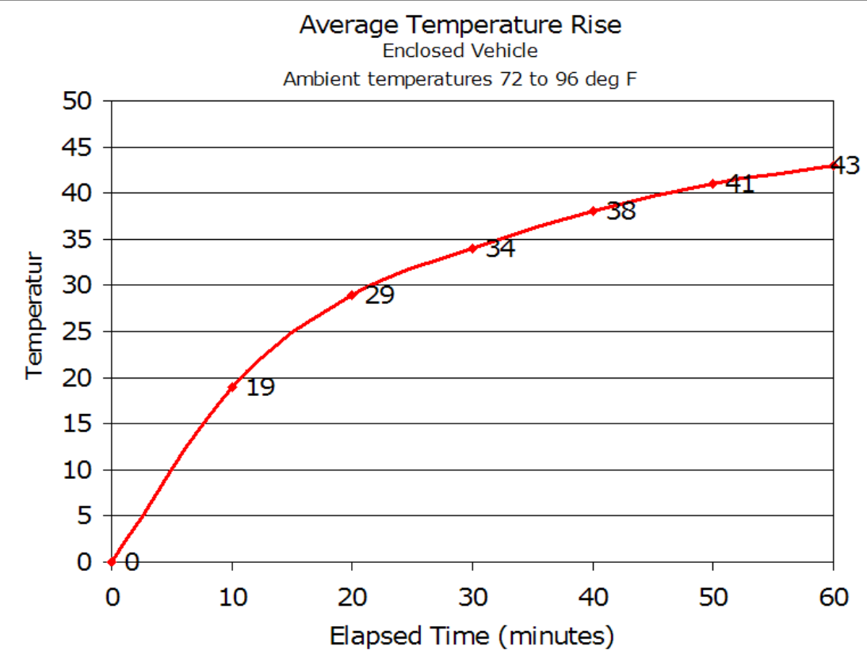
Golden Gate Weather
Average elapsed time and temperature rise 10 minutes ~ 19 degree F 20 minutes ~ 29 degree F 30 minutes ~ 34 degree F 60 minutes ~ 43 degree F 1 to 2 hours ~ 45-50 degree F 2 to 4 hours ~ 50-55 degree F
San Jose State University
www.noheatstroke.org

Slide 11
The Issue – Every Minute Matters
TAKE ACTION IMMEDIATELY
YOU DO NOT KNOW
HOW LONG THE CHILD HAS BEEN
UNATTENDED IN THE VEHICLE
No matter the temperature it just is not safe!

Slide 12
What can I do, so this doesn’t happen within my community?

Slide 13
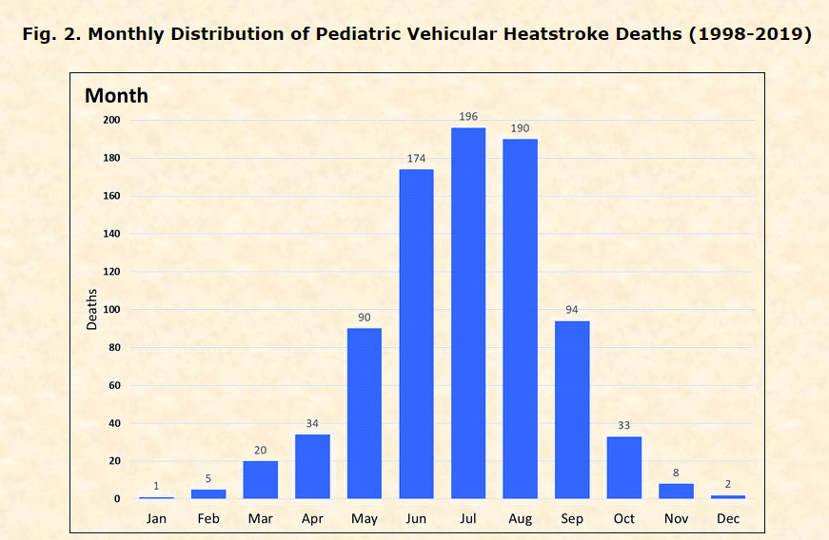
Start now!
San Jose State University
www.noheatstroke.org
Notes:
Start now! You will see that heatstroke fatalities have occurred in every month however there is a spike in the summer months. It depends on were you live it could be 12 months out of the year like FL, CA, TX? A child is never safe alone in a vehicle so it is key to make that connection when raising awareness

Slide 14
Mandatory Training Child Care Providers
Provide educational webinars
Incorporate resources into standard material distributed to parents
Engage child care providers and parents through social media
Strengthen transportation regulations
Notes:
-

Slide 15
Create Reminders – Child Care
Have a protocol in place if a child is late for child care. Call the parent within a few minutes after their typical arrival time.
Equip child care van with a professionally installed alarm that requires the driver or attendant to physically walk to the back of the van to turn off the alarm to ensure every child is out of the vehicle.
Lock the child care van after all children have been accounted for to make sure children can not gain access.

Slide 16
Create Reminders - Parent
Changed routines and distractions have caused people to mistakenly leave children behind in vehicles.
Keep a stuffed animal or other memento in your child’s car seat when it’s empty, and move it to the front seat as a visual reminder when your child is in the back seat.
Place and secure your phone, briefcase, or purse in the back seat when traveling with your child.
Set your cell phone reminder to be sure you dropped your child off at child care.
Set your computer calendar program, such as Outlook, to ask, “Did you drop off at child care today?”
Be extra vigilant if there is a change in routine especially if the parent who generally doesn’t drop off at child care is stepping in.

Slide 17
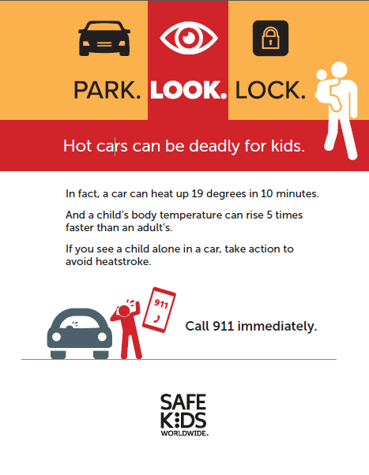
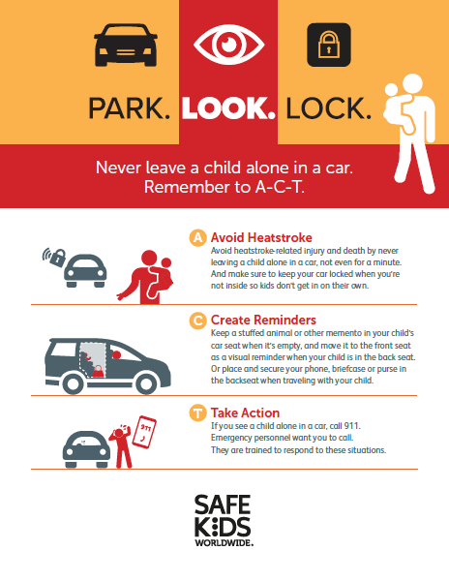
Suite of Communications Resources
Postcard
Tip Sheet (English/Spanish)
Poster (English/Spanish)
Infographic
Notes:
We have a suite of downloadable resources that are found on the Safe Kids website and if you are a coalition, on the Safe Kids Resource Center
Our goal is to make your lives as easy as possible, so for instance our Tip Sheet provides an overview of the issue, talking points, key stats and top safety tips
We also have materials in English and Spanish such as the poster that can be downloaded, printed and displayed in entrances of stores, gas stations, banks childcare center, pediatricians office or anywhere people are walking in and out of a parking lot or caring for children.
Postcards and infographic can be downloaded, printed and passed out at events, childcare centers, inspection stations. And much more.
This is just a sampling, so please go to our website to check it out for yourself

Slide 18
National Organizations
Kids and Cars
National Highway Transportation Administration
Safe Kids Worldwide
National Safety Council
San Jose State University
National Child Passenger Safety Board website
www.cpsboard.org/heatstroke
Notes:
National CPS Board has links to all the organizations materials

Slide 19
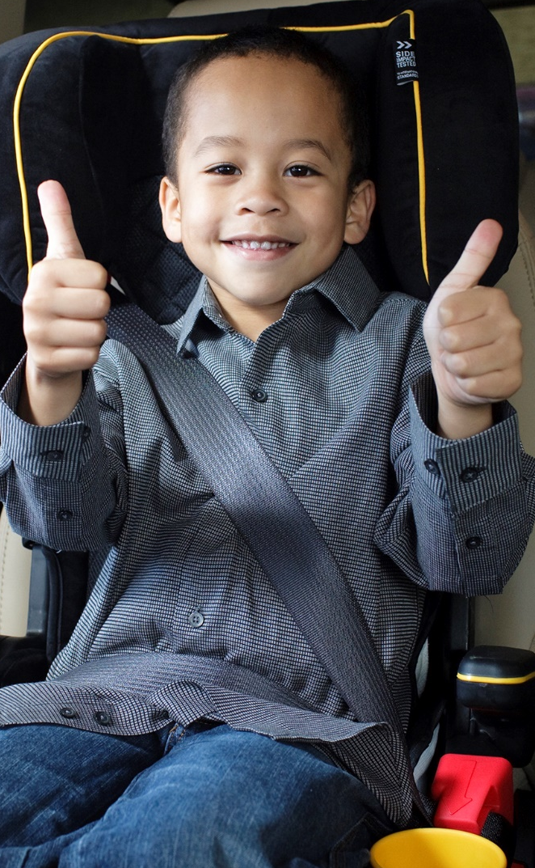
How to get started…
Sign up for Heatstroke Prevention Campaign updates
Receive monthly social media posts, resources and updates that you can share with your friends, colleagues and partners.
https://safekids.salsalabs.org/heatstrokesignup
Build and routinely communicate with your network of partners
Incorporate resources and social media into your existing programs
START TODAY
Notes:
How to get started
So, I bet you are asking yourself, where do I start….
Well, mark your calendars today with National Heatstroke Prevention Day, May 1 and the first Wednesday of the month thru September
Look through the resources to see what works for you and your community; you have the resource list of all the links to our speakers’ sites.
Bookmark on your computer www.noheatstroke.org to get the most current information and sign up for notifications from Jan Null
Join Safe Kids NEW email list for monthly updates and social media posts
Make a contact list of your existing, potential and new partners to routinely provide them with updates, social media posts and resources
Make it easy, incorporate this issue into your other programs

Slide 20
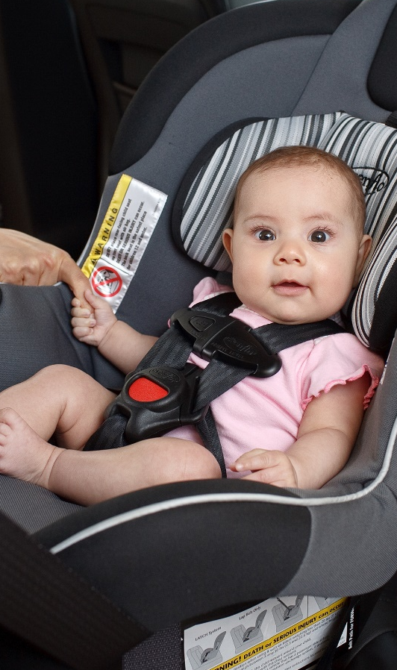
THANK YOU FOR YOUR COMMITMENT TO CHILDREN
Together we can save a life!

