Slide 1



Katie Smith, State Coordinator
4700 Roseville Rd.
North Highlands, CA 95660
916-244-1964
ksmith@thecapcenter.org

Slide 2
Bike Safety Partnerships
Make New Friends, Seize Opportunities and Build Partnerships Along the Way

Slide 3
The Basics
Identify new, complementary agencies within your community
Strong relationships = strong partners
SK coalitions = strong and trusted partnerships
Research and use available tools
        Learn more, move forward, persevere!

Slide 4
Safe Kids California Background
Established 2008 as Advisory Board
Not an on-the-ground coalition
Lead agency Child Abuse Prevention Center; 1 SKC staff
No dedicated unintentional injury background
Board Expertise
  Poison
  Hyperthermia, suicide prevention
  Fire
  Infant Safe Sleep
  Motor vehicle, teen programs
  Child care
  Communications, media, underserved populations
  Child abuse prevention, domestic violence prevention
  Coalition building
  Advocacy

Slide 5
SKC Primary Role
Advocate for strong child injury prevention policy statewide
Strengthen network of 18 chapters/coalitions
Foster development of new coalitions
Outreach to underserved populations
Build new partnerships
Develop new funding sources
Provide educational opportunities
Notes:
One of our biggest challenges is to identify funding opportunities that allow us to provide program funds and encourage new partnerships between the California coalitions and other entities and among the SK coalitions themselves. As the state entity without a coalition on-the-ground, we have the capacity to manage larger grants and provide project oversight and evaluation. The idea is that the coalitions can then conduct activities on the ground.

Slide 6
Meet the Neighbors
Safe Kids Greater Sacramento (coalition)
  Child passenger safety, drowning prevention, ped/bike
Safe Kids Placer County (coalition)
  Child passenger safety, ped/bike, drowning prevention
Safe Kids Amador/Calaveras County (chapter)
  Child passenger safety, bike
California Department of Public Health
  Safe and Active Communities / California Kids’ Plates
  Vehicle Occupant Safety Program
  Technical Assistance Resource Center
  CA Ped/Bike Safety Curriculum Advisory Committee
WALKSacramento
Notes:
SACB is lead injury and violence prevention program within CDPH, conducting statewide planning, research, and prevention activities at state levels, and supporting local jurisdictions to conduct prevention programs to reduce unintentional and intentional injuries. SACB has access to California Kids’ Plates funding, which is generated from the sale of California specialty vehicle license plates that contain an embossed heart, hand, star, or plus sign. Revenue from the sale of Kids’ Plates is deposited into the Child Health and Safety Fund and is appropriated to support three significant child safety issues in California: 1) unintentional childhood injury prevention by CDPH; 2) prevention of child abuse [by the Department of Social Services (DSS)]; and 3) child care licensing and inspection activities (by DSS). The goal of the Kids’ Plates Program is to build capacity for prevention, reducing the often devastating medical, economic, and emotional toll exacted on children, their families, and society as a result of injury, disability, and death.

Slide 7
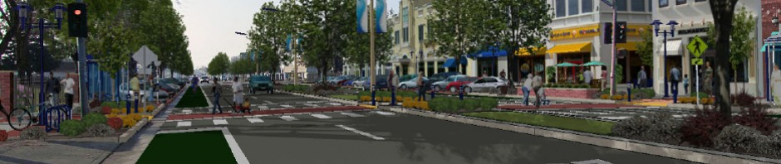
The Neighbors: WALKSacramento
Mission: Create walkable communities throughout the Sacramento metropolitan region…WALKSacramento works to incorporate pedestrian access into transportation and development decisions, to increase funding for pedestrian infrastructure, and to adopt and implement pedestrian master plans for local communities.

Slide 8
The Opportunity (Sep 2012)
RFA from CA Dept. of Public Health (CDPH), Safe and Active Communities Branch (SACB)
“Paving the Way for Safe Routes to School”
  Develop, implement, evaluate a set of small-scale, low-cost interventions with 5-8 underserved CA schools
  GOAL: Build school interest and capacity to conduct year-round interventions to improve safety for walking and bicycling in neighborhoods surrounding school campuses
  Safety focus
3 projects awarded to northern, central and southern regions of state
Notes:
Funding for Paving the Way is provided by CA Kids’ Plates, administered through SACB of CDPH. Paving the Way interventions must focus on safety rather than simply encouraging walking or biking. Long-term goal is to reduce ped/bike injuries, but that’s tough to measure in 2-year period if few children are walking and biking to school due to dangerous conditions.
DESIRED OUTCOME: each site will create a calendar outlining its ongoing SRTS activities during the year subsequent to the 2-year grant period
Applications were due October 11, decision made October 31, start date for 2-year project was to have been January 1
Ultimately, WALKSacramento, with SKC as a subcontractor to WS, won the grant for Northern California. The SOW included 8 schools, 5 of which are in Safe Kids coalition areas.
SKC worked closely with WS in creating the SOW and project budget, which incorporated funding for Katie’s labor and stipends for the participating Safe Kids coalitions, primarily for their activity focused on BTSD and WTSD. An MOU between SKC and the coalitions is pending once a contract is signed.

Slide 9
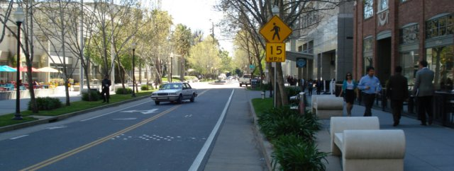
The Partnership
Primary Applicant: WALKSacramento
Experience, resources, skills
Transportation & land use
Incorporation of pedestrian access into transportation and development decisions
Implementation of pedestrian master plans
20 local walk/bike audits
SRTS
Policy advocacy
Community organizing
Evaluation of local conditions
Notes:
WALKSacramento will take the lead on site evaluations and will also conduct activities with planning commissions and other local governmental agencies.

Slide 10
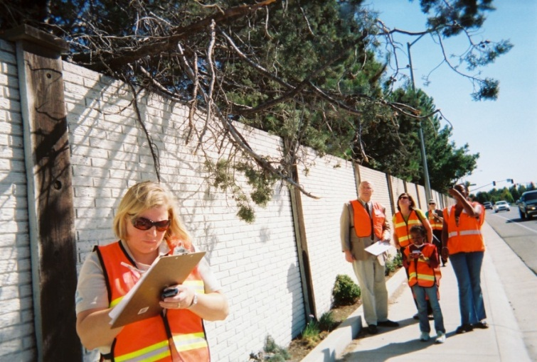
The Partnership
Subcontractor: Safe Kids California
Experience, resources, skills
Affiliation with SKW
Coalition building
Statewide presence
Walk This Way resources
Photo/voice resources
Fluent in Spanish
SK coalitions/BTSD & WTSD
  SK Greater Sacramento
  SK Placer County
  SK Amador/Calaveras
SRTS
Statewide bike/ped curriculum development committee
SKGS: Successful SRTS experience at Deterding Elementary School w/Girl Scouts
Notes:
SK can provide many resources that WS does not have. Their bicycle resources are very limited. SKC can also provide bike/ped curricula – some from SKW and much from the CA Bicycle/Pedestrian Curriculum development committee. Katie, a former educator, will provide in-school assembly and classroom education at each school.
Deterding School is located in Carmichael, a suburb of Sacramento. In 2008 Deterding’s Jr. Girl Scout Troop 2706 decided to pursue a Girl Scouts USA Bronze Award for a community leadership project. The mother of one of the Girl Scouts is Sonja Atkins, who at that time was coordinator of SKGS. SKGS delivered a presentation to the troop on walking safety. Incentivized by a small photojournalism award from SKGS, the troop subsequently decided to document reasons why students did not feel safe while walking to schools. SKGS helped them conduct a walk audit, document hazards, and create a You Tube video. Once the troop’s research was shared, the school principal contacted the CHP to improve safety around the school by providing fluorescent orange cones to designate safe drop-off sites. Then they launched Walking Thursdays with walking school buses from three drop-off sites. SKGS provided educational assemblies and another small award for student incentives. Fed Ex became involved through SKGS and the school PTA also got into the act, resulting in a 500% increase in students walking and biking every Thursday. When the girls from the Girl Scout troop moved on to middle school, the PTA adopted Walking Thursdays as a permanent program. With budget cuts in 2009 which eliminated all non-mandatory busing, parents convinced the school district to put in a pathway from a residential neighborhood through Deterding’s western play yard and Sacramento DOT installed a crosswalk. Ultimately, the school applied for and won a large CalTrans grant. SKGS activities with the Girl Scout Troop laid the groundwork and generated the community and school interest and support.

Slide 11
The Schools
Thomas Edison Institute, Sacramento (urban, low-income)
  417 students, 76% free or reduced-price lunches
  20% walk or bike to school
  No sidewalks or shoulders on collector street with 13,000 vehicles/day
Camellia Basic Elementary (urban, low-income)
  474 students, 78% free or reduced-price lunches
  Bicyclists travel along/cross multiple roads with > 20,000 vehicles/day
  Strong community support, expand focus on health and physical activity, and solve pick-up/drop-off problems
Ione Elementary, Ione (rural)
  449 students, 51% free or reduced-price lunches
  Dangerous location on Highway 104
  Vast majority of students travel by bus or vehicle
  Previous discussions with Caltrans and city to improve Highway 104
Notes:
We identified the schools, in part, with our Safe Kids coalitions. The RFA required that none of the participating schools had received previous SRTS infrastructure grants and that they also met at least of one of two requirements: 1) rural schools, or 2) 75% of students were eligible for free or reduced-price meals.
We located school demographic information on the CA SRTS website and the TARC site for SRTS (Technical Assistance Resource Center).

Slide 12
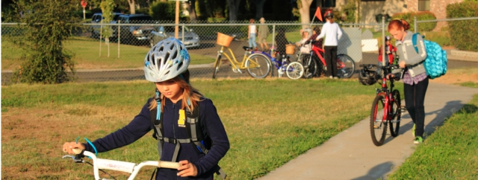
The Schools
Newcastle Elementary (rural)
  363 students, 17% free or reduced-price meals
  Hilly, windy streets, no sidewalks, dirt shoulders and unmaintained paths
  Walking and biking for recreation only
Auburn Elementary
489 students, 54% free or reduced-price meals
Student catchment area includes Highway 49, a busy 4-lane road with 60,000 vehicles/day
Need to increase safety of bicyclists
Notes:
All principals selected the activities they would like to engage in at their schools and all are enthusiastic about the opportunities to improve pedestrian and/or bicycle safety.

Slide 13
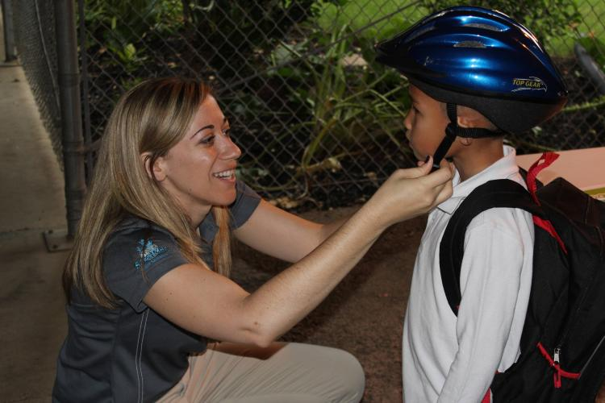
Activity to Date
Collaboration with WS and 3 Safe Kids coalitions
  Building trust, sharing responsibilities
  Collecting and sharing resources
Building relationships within 5 school communities
  Meetings, phone calls, getting the lay of the land
  Reassurances
Bike to School Day
  5 schools
  Generating excitement
  Enlisting media interest and support

Slide 14
Building and Strengthening Relationships
School Principals
Parent-Teacher organizations /parent leads
Lead teachers
Bike shop owners
Chief of Police
California Highway Patrol
UC Davis Helmet program
Sacramento Clean Cities Coalition
Sacramento Metropolitan Air Quality Management District
AAA
Parks & Recreation
Sacramento Area Council of Governments (SACOG)
Scout Troops
NHTSA
Safe Kids Coalitions
Notes:
We have met police chiefs, parks and recreation officials, AAA volunteers, and through a volunteer parent we were put in contact with Metropolitan Air Quality Management District.
At their request we submitted an article about the partnership between WS and Safe Kids and our activities on BTSD. They will tweet and point to the article and their mascot Scooter will “like” the article to get additional dissemination of BTSD successes. They would like to discuss an idle reduction effort at schools, which may lead to additional school activities and another angle for “selling” SRTS coalition development. Idling burns a lot of fuel, puts pollutants into the air and costs parents money.

Slide 15
Where Are We Now? A cautionary tale…
Contract/Grant Start Date Delays
  January 1
  March 1
  March 15
  Expected start date July 1???
SKC now a grantee, not a subcontractor – increased funding
1 re-write and submission of SOW and budget, another to come…
Grant period extended by 6 months
National SRTS Conference in Sacramento August 13-15
Walk This Way / Walk to School Day
Other School activities on hold…

Slide 16
Katie Smith, State Coordinator
4700 Roseville Rd.
North Highlands, CA 95660
916-244-1964
ksmith@thecapcenter.org

