Slide 1
Never Leave a Child Alone in a Car
“Roll Call” Presentation
Working together to raise awareness and save lives.

Slide 2
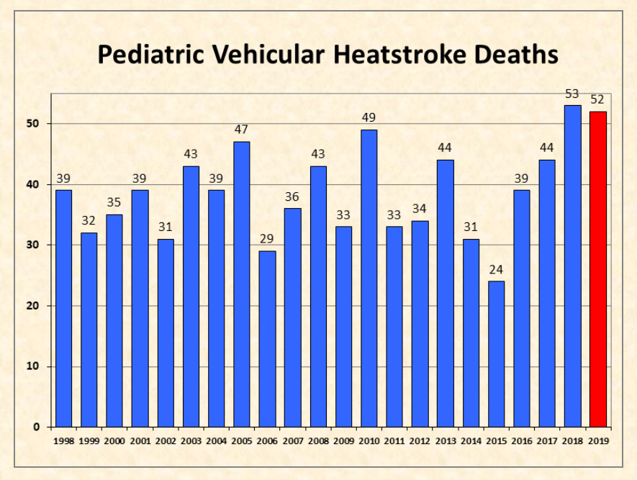
As of March 1, 2020
San Jose State University
www.noheatstroke.org
Notes:
In the past two years over 100 children have died with a total of 845 since 1998
Cases are on the rise and childcare centers are indirectly or directly involved in nearly 50 percent of these cases
The data provided within this presentation comes from Golden Gate Weather from 1998 to present

Slide 3
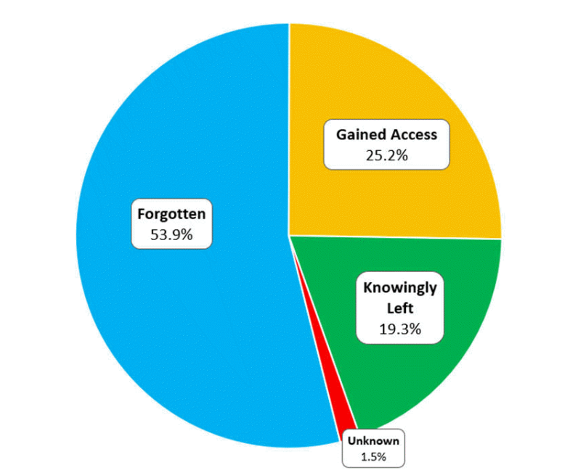
Circumstances Resulting in Heatstroke Deaths of Children in Vehicles
  100% Preventable
79% Unintentional
San Jose State University
www.noheatstroke.org
Notes:
This is 100% preventable with the help of bystanders

Slide 4
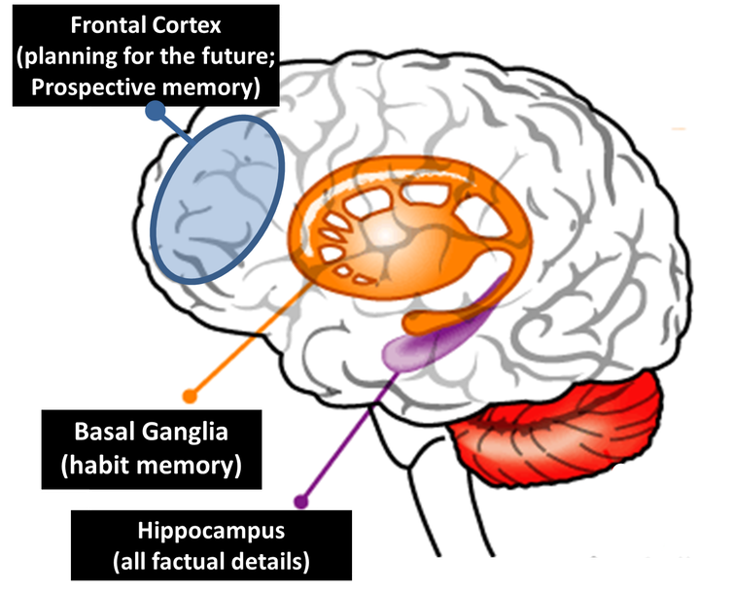
How can a child be forgotten in a vehicle?
It can happen to ANYONE, EVEN YOU!
Two Types of Memory:
Prospective Memory - the here and now, storage of new information, conscious decision making
Habit Memory - “autopilot”, doing things that are routine without thinking about it, turns on automatically without a conscious decision to do so
Dr. Diamond https://bit.ly/28MGZgp
Kids and Cars
Notes:
Slide by Janette Fennell – Kids and Cars
If you are sitting back thinking “how could a parent forget their child” “that would NEVER happen to me”. Think again. This happens to professionals, doctors, lawyers, school teachers and first responders. It happens to nearly 54% of children.
There is a physical reason how this happens: Please read to be able to explain to the group; Dr. Diamond https://bit.ly/28MGZgp

Slide 5
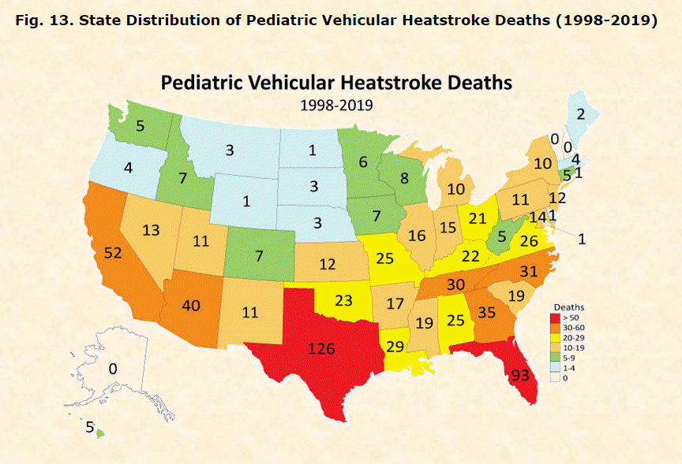
San Jose State University
www.noheatstroke.org
Notes:
Fatalities have been recorded in 47 states and the District of Columbia.

Slide 6
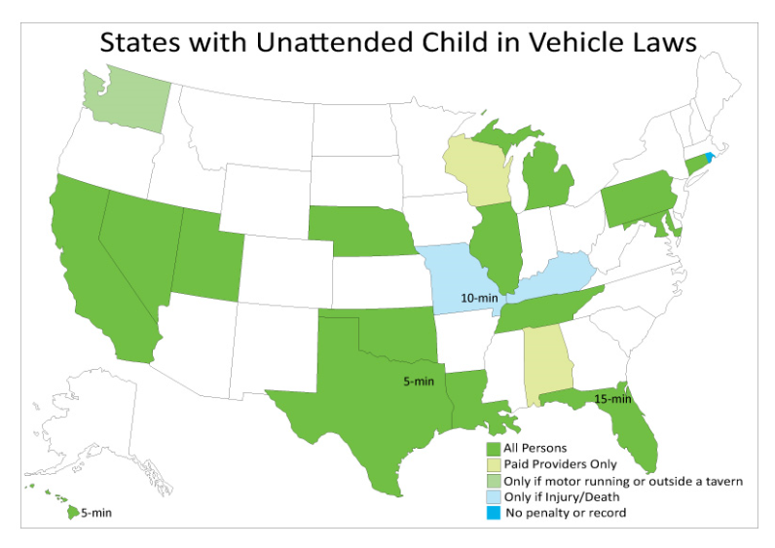
San Jose State University
www.noheatstroke.org/legal.htm
Notes:
https://www.noheatstroke.org/legal.htm

Slide 7
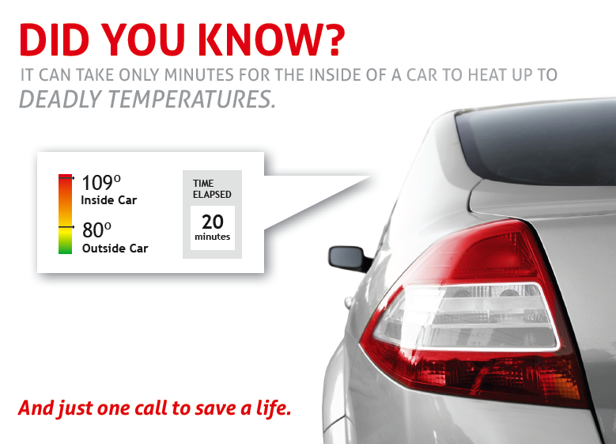
The Issue
Leading cause of non-crash, vehicle-related deaths for children.
A car can heat up 19 degrees in 10 minutes. And cracking a window doesn’t help.
The body isn’t able to cool itself quickly enough.
Young children are particularly at risk – bodies heat up three to five times faster than an adult’s.
When internal temperature gets to 104 degrees, major organs begin to shut down. At 107 degrees, the child can die.
San Jose State University
www.noheatstroke.org
Notes:
Why is it important for a person to take action and call 911 immediately?
Children left alone in a car is the #1 danger regardless of temperature . With the momentum that you generated last year it continued into the cooler months. I received countless google alerts of bystanders taking action and calling 911 this winter. I believe the message was clear, regardless of temperature, a child should never be left alone in a car, not for a minute.
Even on a mild day, the inside of a car can quickly become very hot. That’s especially dangerous for kids:
a child’s body heats up 3-5 times faster than an adult body.
Temperatures inside a car can rise 19 degrees in 10 minutes.
Leaving a window slightly open has no effect on the inside temperature of a vehicle.
Heatstroke occurs when the body isn’t able to cool itself quickly enough and the body temperature rises to dangerous levels.
Young children are particularly vulnerable since their internal systems to regulate body temperature are not fully developed – there is little margin for error.
When the body temperature reaches 104 degrees, the internal organs start to shut down. When it reaches 107 degrees, the person dies.
Symptoms can quickly progress from flushed, dry skin and vomiting to seizures, organ failure or death.
A person doesn’t know how long the child has been in the car and every minute counts.
One doesn’t know how long a child has been unattended in the car and time plays a critical factor when heatstroke is involved and with safety overall.

Slide 8
The Issue – Every Minute Matters
TAKE ACTION IMMEDIATELY
YOU DO NOT KNOW
HOW LONG THE CHILD HAS BEEN
UNATTENDED IN THE VEHICLE
No matter the temperature it just is not safe!

Slide 9
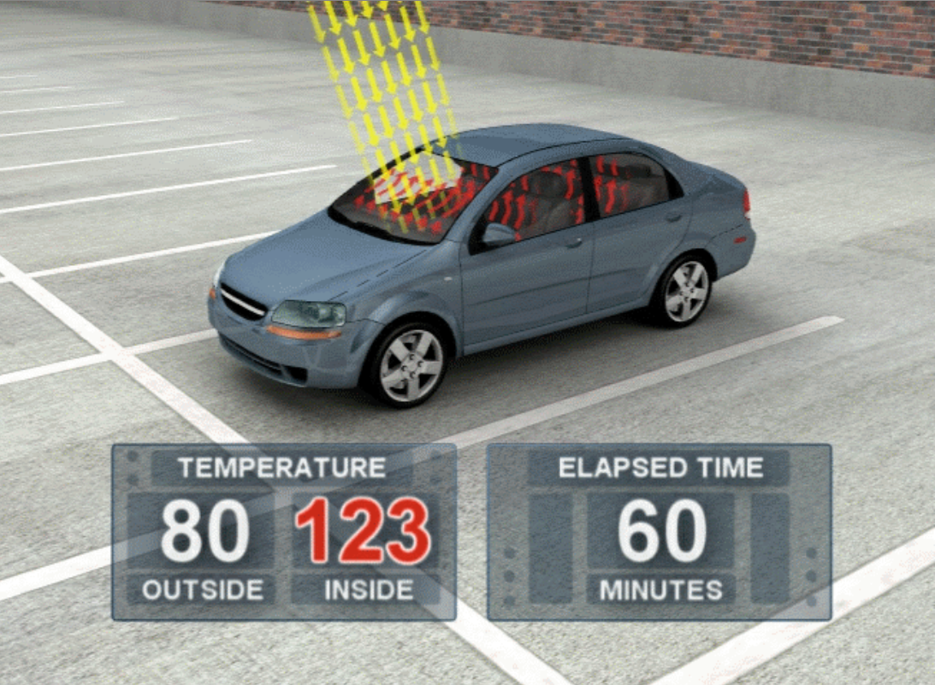
Vehicles Can Heat Up
19 degrees in 10 minutes
Studied temperature rise in enclosed cars on 16 dates between May 16 and Aug. 8, 2002. (see graph of 16 case days)
Ambient temperature were between 72 and 96 degrees F
Dark Blue mid-size sedan with medium grey interior
Also tested with windows “cracked”
Right Click – “Open Link”
Animation courtesy of General Motors and Jan Null, San Jose State University
San Jose State University
www.noheatstroke.org

Slide 10
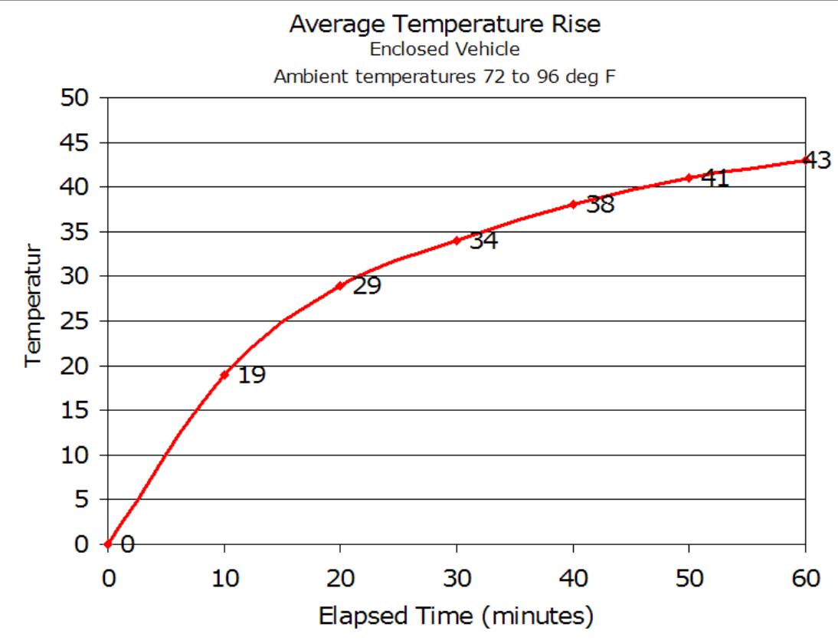
Golden Gate Weather
Average elapsed time and temperature rise
10 minutes ~ 19 degree F
20 minutes ~ 29 degree F
30 minutes ~ 34 degree F
60 minutes ~ 43 degree F
1 to 2 hours ~ 45-50 degree F
2 to 4 hours ~ 50-55 degree F
San Jose State University
www.noheatstroke.org

Slide 11
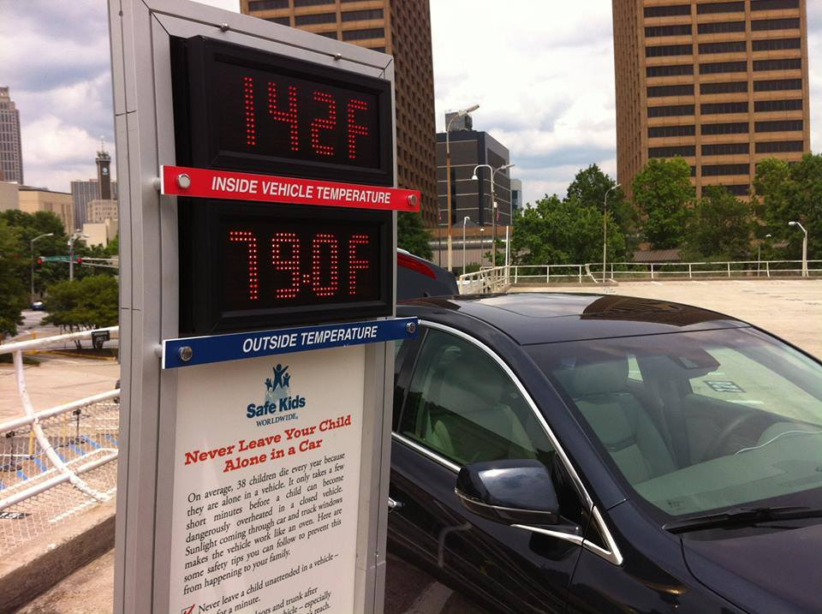
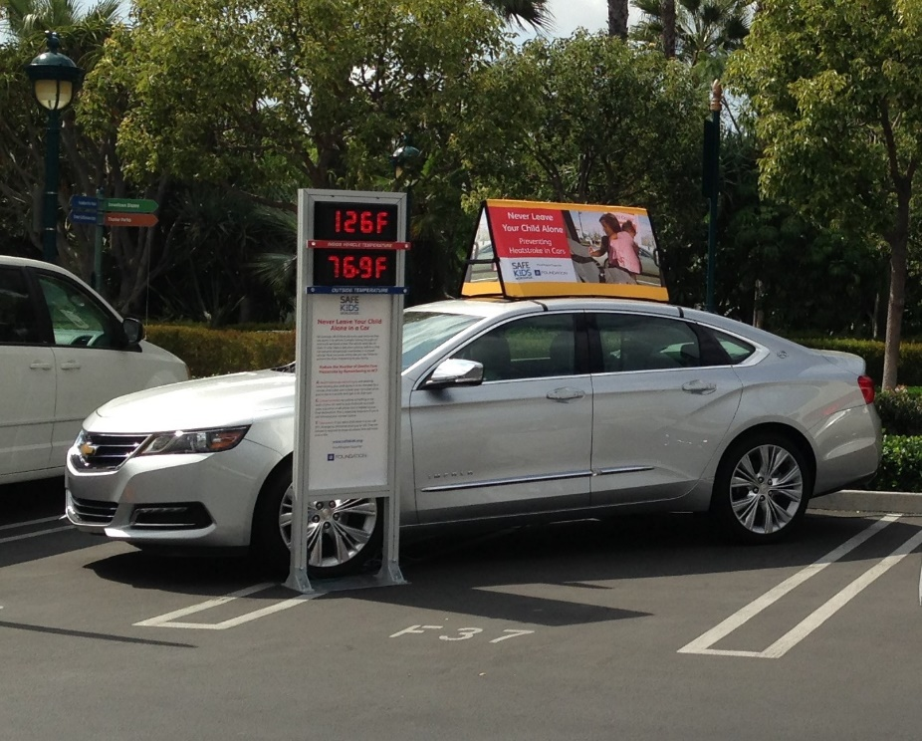
Average elapsed time and temperature rise
10 minutes ~ 19 degree F
20 minutes ~ 29 degree F
30 minutes ~ 34 degree F
60 minutes ~ 43 degree F
1 to 2 hours ~ 45-50 degree F
2 to 4 hours ~ 50-55 degree F
San Jose State University
www.noheatstroke.org

Slide 12
Symptoms of Heatstroke
Flushed, dry skin
Vomiting
Disorientation
Agitation
Confusion
Sluggishness
Seizure
Loss of consciousness

Slide 13
First Responders
Have the attention of the community
People listen
Educate community members on the dangers of children unattended in vehicles
  Share what you know and raise awareness
Encourage bystanders to take action and call 911 if they spot a child unattended in a vehicle regardless of temperature

Slide 14
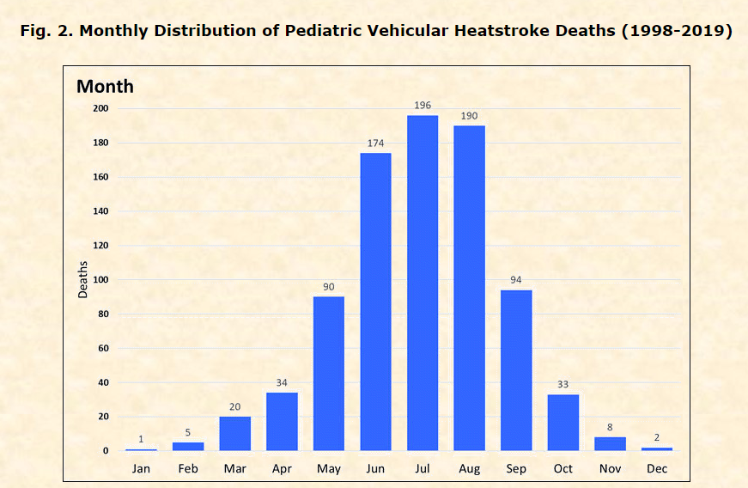
Start now!
San Jose State University
www.noheatstroke.org
Notes:
Start now! You will see that heatstroke fatalities have occurred in every month however there is a spike in the summer months. It depends on were you live it could be 12 months out of the year like FL, CA, TX? A child is never safe alone in a vehicle so it is key to make that connection when raising awareness

Slide 15

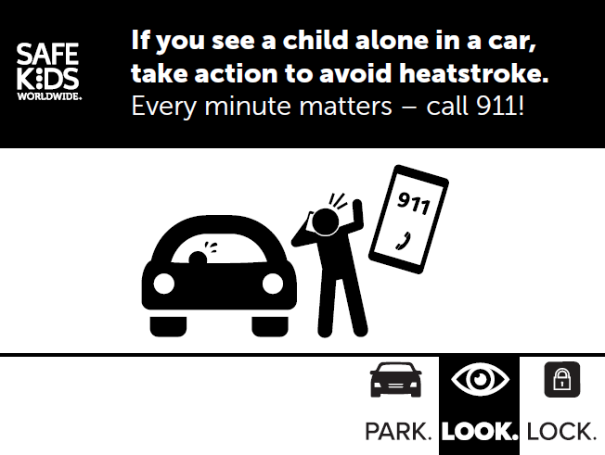
First Responder Tool Kit
  Public Awareness Campaign
  Decals for your vehicle or Fleet . (Color and Black/White)

Slide 16
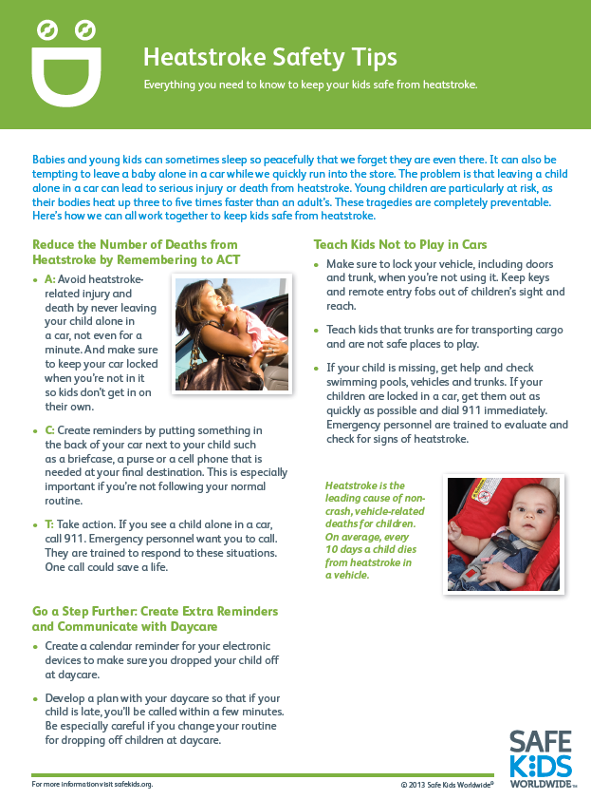
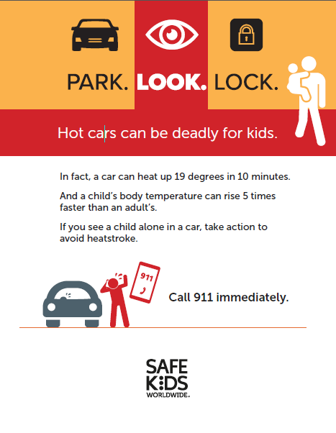
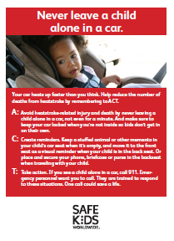
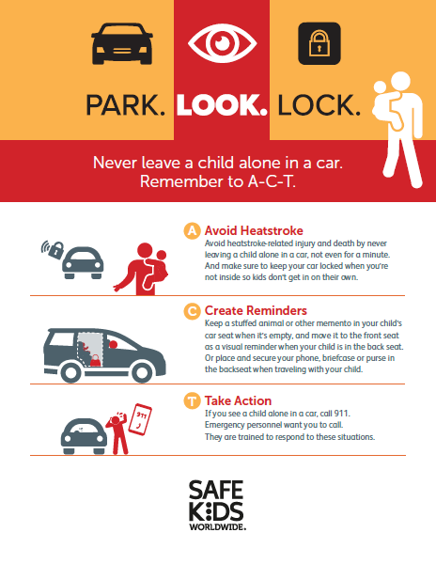
Suite of Communications Resources
Postcard
Tip Sheet (English/Spanish)
Poster (English/Spanish)
Infographic
Notes:
We have a suite of downloadable resources that are found on the Safe Kids website and if you are a coalition, on the Safe Kids Resource Center
Our goal is to make your lives as easy as possible, so for instance our Tip Sheet provides an overview of the issue, talking points, key stats and top safety tips
We also have materials in English and Spanish such as the poster that can be downloaded, printed and displayed in entrances of stores, gas stations, banks childcare center, pediatricians office or anywhere people are walking in and out of a parking lot or caring for children.
Postcards and infographic can be downloaded, printed and passed out at events, childcare centers, inspection stations. And much more.
This is just a sampling, so please go to our website to check it out for yourself

Slide 17
Never Leave a Child Alone in a Car
Key Messaging
Safe Kids is asking everyone to help protect kids from this preventable tragedy by remembering to ACT.
A: Avoid heatstroke-related injury and death by never leaving a child alone in a car, not even for a minute. And make sure to keep your car locked when you’re not in it so kids don’t get in on their own.
C: Create reminders by putting something in the back of your car next to your child such as a briefcase, a purse or a cell phone that is needed at your final destination. This is especially important if you’re not following your normal routine.
T: Take action. If you see a child alone in a car, call 911. Emergency personnel want you to call. They are trained to respond to these situations. One call could save a life.

Slide 18
Customizable Resources
Safe Kids Worldwide
https://www.safekids.org/heatstroke
https://www.safekids.org/take-action-prevent-heatstroke

Slide 19
National Organizations
Kids and Cars
National Highway Transportation Administration
Safe Kids Worldwide
National Safety Council
San Jose State University
National Child Passenger Safety Board website
www.cpsboard.org/heatstroke
Notes:
National CPS Board has links to all the organizations materials

Slide 20
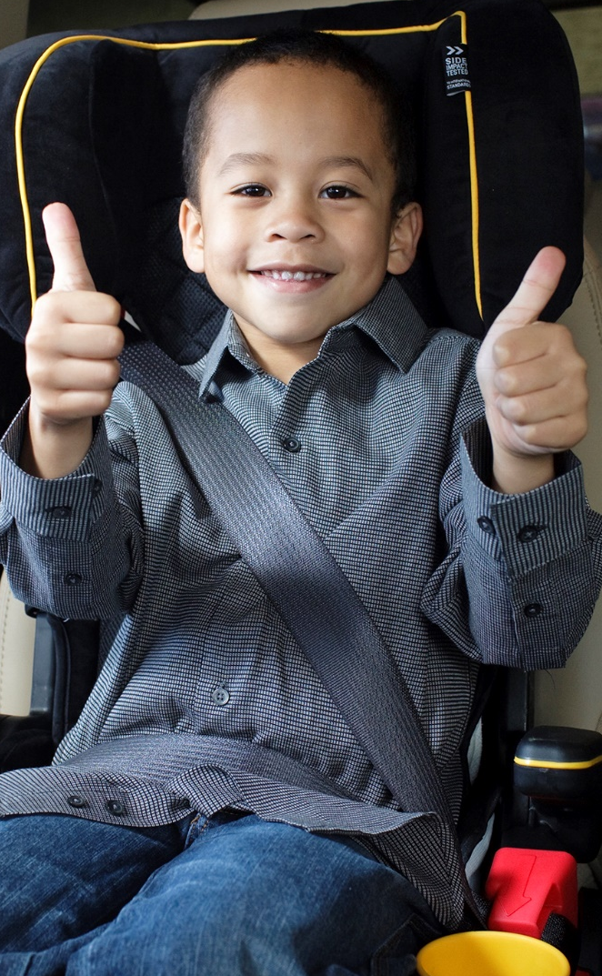
How to get started…
Sign up for Heatstroke Prevention Campaign updates
  Receive monthly social media posts, resources and updates that you can share with your friends, colleagues and partners.
  https://safekids.salsalabs.org/heatstrokesignup
Build and routinely communicate with your network of partners
Incorporate resources and social media into your existing programs
START TODAY

Slide 21
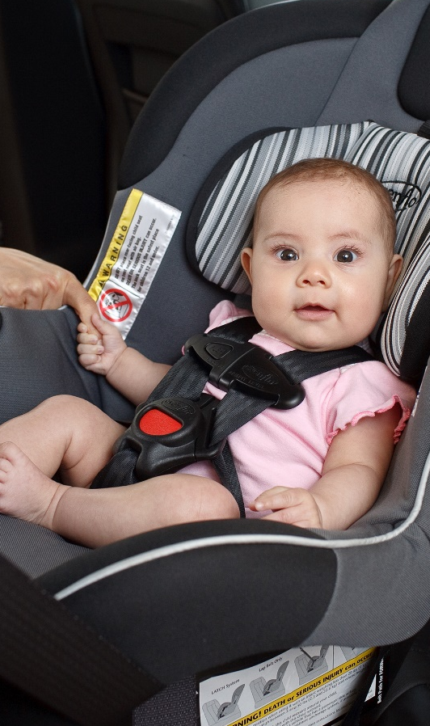
THANK YOU FOR YOUR COMMITMENT TO CHILDREN
Together we can save a life!

